Slide 1
Fund 2 Performance Review | Q1 2025
April 2025

Slide 2
Executive Summary
Asset Management Operational Review
Financial Overview
Valuations
Fund Forecast

Slide 3
Executive Summary | Key Areas to Monitor
Focus Area | Commentary
Downtime & Vacancies | Leasing Activity: During the quarter, we secured 18 new leases, achieving an 11% leasing spread. Despite this positive development, we experienced a negative net absorption of 500K SF, leading to a decline in physical occupancy to 88.3% and economic occupancy to 86.5%. The economic occupancy is expected to drop to 83% in Q2 and 81% in Q3 Financial Impact: As a result, our SS NOI decreased by 400K to 13.8M, representing a 5.4% YoC%, in line with our forecasts. Additionally, our Fund Reserves dropped by 4M, from 51M to 47M, primarily due to distributions of 4.6M.
Availability | In our stress case, the debt availability is forecasted to drop to ($6M) in Q4 2025 with no dispositions or refi, but it remains at +$38M in Q4 when factoring in the disposition plan (with no refi) Even if we refi, we still need to closely monitor our disposition plan since we will run into an FCCR issue with no dispositions and a refi at higher leverage (FCCR will fall to 1.47x in Q1 2026) To ensure positive reserves and FCCR under stress tests, we need to complete the disposition of $30M. Our team is working to generate $69M in sales proceeds, with ~$18M of proceeds expected to be received during Q2 from 3 properties currently under contract.
Cashflow & Distributions | For each of the last few quarters, we have distributed $4.6M (3.7% Core FFO). Per the latest model, we expect to generate Core FFO of $4.0M (~3.2%) for the next few quarters The Fund can sustain distributing $4.6M in Q1, despite $3.8M Core FFO. Future distributions will be dependent upon completing dispositions and relying on capital gains After refi, Core FFO will drop to $2.5-3.5M for the remainder of 2025, but we will be able to distribute ~$50M of refi proceeds back to investors (subject to payout ratio)

Slide 4
Executive Summary | Key Areas of Focus
Focus Area | Commentary
Financing & Target Leverage | Our Investments team is currently working with CBRE to take the Fund to market for a potential recap in 2025 In parallel, our Finance team is also working with CBRE to explore a potential refi of the credit facility (Project Double). Full refi of the facility and a partial refi of only stabilized assets are being explored simultaneously If the Fund proceeds with the partial refi of only stabilized assets, the Fund will proceed with adding extensions for the facility, which will remain in place for unstabilized assets
Delinquencies
Covenants | As of Q1, the fund is in compliance with all covenants. Apollo Loan: We are approaching the Debt Yield covenant, with an actual yield of 8.78% compared to the covenant of 8.75%. To mitigate this risk and due to the properties we aim to sell, the team is working on a property swap within this loan to maintain compliance. Key Bank Occupancy Covenant: Given the current low occupancy, the team is closely monitoring the occupancy covenant to ensure we remain compliant. Currently, our occupancy stands at 89%, compared to the covenant of 85%. If necessary, the team is prepared to remove properties from the pool to ensure continued compliance.

Slide 5
Executive Summary | Asset Management Operational Review
Leasing Spreads:
18 leases were signed in Q1 across 6 different markets, achieving 11% leasing spread over prior leases
Since inception, the Fund has signed 167 leases with 28% spread over prior leases
Escalations:
Escalations in Fund II are consistently above underwriting
Q1 escalations were 3.73% against BP of 2.73%, while leases signed in last 12 months achieved 3.76% escalations vs 2.78% BP
Renewal Rate:
Renewal Rate for Fund II is trending at ~66% for the past 4 quarters
Q4 renewal rate of 72% was well above the ITD average of 53%
Downtime:
The Fund currently has 31 vacant spaces, 14 of which have extended downtime over 10 months
Vacant spaces are driven by a variety of factors including slow leasing activity, delinquencies, delayed timelines due to construction, and/or failed dispositions
The Fund has an additional 3 early terminations with tenants who are expected to vacate by the end of Q2 2025 at the latest. These are a result of distress issues such as delinquencies and evictions.

Slide 6
Executive Summary | Asset Management Operational Review
A/R
Quarterly Overview: Overall, there were no major changes during the quarter.
A/R: The Fund's total A/R balance at the end of Q1 was $1.1M, down from $2.4M. This decrease is primarily attributed to the billing and collection of CAM receivables.
Write-offs / Allowances: During the quarter, we successfully recovered $300K, mainly from two payments received from vacated tenants.
Bad Debt Expenses: Since inception, our bad debt expenses have averaged around 1% of total revenue.
Economic Occupancy:
Forecast Manager projects 83.6% economic occupancy for the Fund in 2025

Slide 7
Executive Summary | Financial Overview
NOI & YOC:
$13.9M NOI for Q1, decreasing from $14.2M in Q4, due to cyclical increases in operating expenses and vacancies. This NOI represents a ~$0.1M decrease from budget
Yield on Cost is 5.5% for Q1, which is slightly lower than 5.6% in Q4. Forecasted YoC % for the quarter was 5.4%
Same Store NOI trend over the last 4 quarters is stagnant
FFO:
Core FFO is 3.1% or $3.8M for Q1, with AFFO of 0.7% or $0.8M after subtracting out $3.4M of CapEx and adding back $0.4M of financing costs amortization
Core FFO was ~3.3% in 2022 & 2023, decreasing to ~3.0% throughout 2024. This is primarily due to dispositions (which resulted in lower NOI with same equity base) and higher interest rate due to Apollo refi (~6% Apollo vs ~5% KeyBank Facility)
Financing & Leverage:
The outstanding debt as of the end of Q1 was $489M, spread across $376.5M credit facility and $112.5M Apollo
As of the end of the quarter, the WALTC of the Fund was 48.2% and the WALTV was 39.4%
The Fund was 98% hedged as of the end of the quarter, however the pro-forma following cap expirations is 86%
Apollo Loan: We are approaching the Debt Yield covenant, with an actual yield of 8.78% compared to the covenant of 8.75%. To mitigate this risk and due to the properties we aim to sell, the team is working on a property swap within this loan to maintain compliance.

Slide 8
Executive Summary | Valuations & Fund Forecast
Valuations:
FMV of Investments is $1,252M, increased from $1,243M in Q4, driven by $6.4M mark-to-market appraisal adjustments and $3M CapEx
Inception to date, the Fund acquired $1,075M Total Cost. After completing $54M of CapEx, selling $128M of net proceeds, and creating $253M value creation through appraisals, the Fund reached the current FMV of $1,252M
18 dispositions have been completed inception to date at a Realized Gain of $23.5M over Total Cost (including CapEx)
The total equity called of $500M stands at $719M NAV as of the end of the quarter, representing a 44% equity upside
Fund Forecast & Debt Availability:
The Fund finished the quarter with $44.4M Debt Availability and $2.8M Net Current Assets, bringing total Fund Reserves to $47M. This represents a slight decrease from $51M Q3 reserves, mainly due to $4.6M distribution during the quarter
In our stress case, the debt availability is forecasted to drop to ($6M) in Q4 2025 with no dispositions but remains at +$38M in Q4 when factoring in the disposition plan. When factoring in Net Current Assets as well, the minimum fund reserves are $26M with dispositions
The Fund is forecasted to grow from 5.60% Yield on Cost in 2025 to 6.47% Yield on Cost in 2027 per the latest model
This Yield on Cost growth reflects ~$113M of Capex, TI & LC forecasted over the fund term
At an assumed 5.85% exit cap rate, this represents a 13.2% Gross IRR and 10.6% Net IRR for the Fund assuming sale on Jan 1, 2028

Slide 9
Executive Summary | Key Recommendations
Distributions:
For each of the last few quarters, we have distributed $4.6M (3.7% Core FFO). Per the latest model, we expect to generate Core FFO of $4.0M (~3.2%) for the next few quarters
The Fund can sustain distributing $4.6M in Q1, despite $3.8M Core FFO. Future distributions will be dependent upon completing dispositions and relying on capital gains
After refi, Core FFO will drop to $2.5-3.5M for the remainder of 2025, but we will be able to distribute ~$50M of refi proceeds back to investors (subject to payout ratio)
As of today, there were 2 additional dispositions under contract for sale (420-440 Benigno (KOR Center) and 900 Kennedy) and 4 additional properties under PSA negotiation. The completion of these in Q2 is projected to generate ~$18M of proceeds which can be used to reduce the outstanding credit facility and support 3.7% distribution to investors
Recap & Refi Considerations:
The Investments team is currently working with CBRE to take the Fund to market for a potential recap in 2025
In parallel, the Finance team is also working with CBRE to explore a potential refi of the credit facility (Project Double). Full refi of the facility and a partial refi of only stabilized assets are being explored simultaneously
If the Fund proceeds with the partial refi of only stabilized assets, the Fund will proceed with adding extensions for the facility, which will remain in place for unstabilized assets

Slide 10
Executive Summary | Portfolio ID
As of March 31st, 2025
Market Allocation by Purchase Price
Performance Metrics
Number of Buildings | 181
Total Size (SF) | 10.2M
Total Purchase Price | $958M
Average Price PSF | $93.9
Fair Market Value⁽¹⁾ | $1.25B
Total Occupancy⁽²⁾ | 88.3%
Average WALT (Years) | 3.2
Loan-to-Total Cost | 47.7%
Loan-to-Value | 39.0%
ITD Distributions | $42M
Disposed Buildings / Purchase Price / Sale Price | 24/$101M/$133M
Dispositions Gross / Net IRR | 36%/28%
1.6% | Memphis
4.2% | Cincinnati
1.4% | Tampa
2.0% | Jacksonville
2.8% | San Antonio
17.0% | Chicago
A
19.6% | Philadelphia
Columbus | 0.9%
Northern NJ | 16.8%
Atlanta | 17.2%
 | A
Dallas | 16.6%
Secondary Value
Markets
Gateway Markets
Secondary Growth
Markets
Primary Value Markets
Primary Growth Markets
Metrics exclude property dispositions through 3/31/25
⁽¹⁾According to quarterly valuations (still open for Q1 appraisal adjustment)
⁽²⁾Represents adjusted physical occupancy based on SF occupied at end of quarter after removing leases with pending terminations

Slide 11
Asset Management Operational Review

Slide 12
Fund Occupancy

Slide 13
Contract Occupancy | Net Absorption – Fund 2
 | 2023 - Adjusted | Q1 2024 | Q2 2024 | Q3 2024 | Q4 2024 | FY 20224 | Q1 2025
Fund SF | 11,705,150 | 10,815,504 | 10,578,968 | 10,430,213 | 10,269,069 | 10,815,504 | 10,195,978
Beg Period Occupied SF | 10,688,883 | 10,278,327 | 10,039,225 | 9,847,462 | 9,686,981 | 10,278,327 | 9,695,562
Beg Period Contract Occupancy | 91.3% | 95.0% | 94.9% | 94.4% | 94.3% | 95.0% | 95.1%
SF Expired | 460,988 | 117,060 | 133,646 | 78,525 | 155,582 | 484,813 | 607,091
SF Commenced | 674,807 | 73,994 | 65,283 | 0 | 76,442 | 215,719 | 93,379
Net Absorption | 213,819 | -43,066 | -68,363 | -78,525 | -79,140 | -269,094 | -513,712
Disposition SF | 889,646 | 236,536 | 148,755 | 161,144 | 160,925 | 707,360 | 0
Occupied SF reduced due to Sale | 624,375 | 196,036 | 123,400 | 81,956 | 0 | 401,392 | 0
Acquisition SF |  |  |  |  | 81,400 | 81,400 | 0
End Period Occupied SF | 10,278,327 | 10,039,225 | 9,847,462 | 9,686,981 | 9,689,241 | 9,689,241 | 9,181,850
End Period Fund SF | 10,815,504 | 10,578,968 | 10,430,213 | 10,269,069 | 10,189,544 | 10,189,544 | 10,195,978
End Period Contract Occupancy | 95.0% | 94.9% | 94.4% | 94.3% | 95.1% | 95.1% | 90.1%
Leases pending Yardi Terminations* |  |  |  |  |  |  | 174,570
Adjusted Occupancy |  |  |  |  |  |  | 88.3%
*Pending Terminations include: Texpak, Simonik, and Global Concentrate
Top 5 Tenant Move-ins
Property | Tenant Move-In | SF | Rent PSF
19-05 Nevins Road (xnj19nev) | RD Foods America, Inc. (t0000627) | 50,591 | $15.25
1 Territorial Court (xil1terr) | Turbo Systems US Inc. (t0000511) | 22,001 | $8.58
1100-1150 Howard (xil1100h) | Genband Industries, LLC (t0001359) | 8,613 | $8.00
201 James Street (xil201ja) | A&J Direct, Inc. (t0001418) | 4,680 | $10.00
231 James Street (xil231ja) | Quench USA, Inc. (t0001417) | 7,494 | $10.26
 |  | 93,379 | $12.35
Several move outs in Q1 lead to a negative net absorption of ~514K SF
End of quarter contract occupancy is 90.1%
Terminated tenants that are still showing in contract occupancy account for ~175K SF and make up ~1.8% of the portfolio. Adjusted occupancy of Fund 2 is ~88.3%
1Q25 Fund SF is adjusted by 6K SF to match current reports, primarily driven by minor changes in SF.
Property | Tenant Move-Out | SF | Move-Out Reason
See next page

Slide 14
Physical Occupancy | Net Absorption – Fund 2 Cont.
Property |  | Tenant Move-Out | SF | Rent PSF | Move-Out Reason
108 North Gold Drive |  | Webtech, INC | 23,912 | $7.77 | Business Closure
1157 Battlecreek Road |  | Motorvation LLC | 166,493 | $5.03 | Financial Difficulty
1211 Ford Road |  | Northeast Building | 106,045 | $5.06 | Change in Business Operations
1601-1641 Sherman Ave |  | Seminole Wire & Cable | 13,869 | $7.96 | Relocation for Business Contraction outside of market
1980 Old Cuthbert Road |  | Ribbons Express, Inc. | 14,000 | $8.07 | Renovation or Redevelopment
2125 Vanco Drive |  | Titan Solar Power TX Inc | 26,532 | $10.35 | Bankruptcy
225 Bobrick Drive |  | Redeemed Plastics | 33,340 | $4.76 | Financial Difficulty
3001 Irwin Road |  | Del-Val Food Ingredients | 24,600 | $5.22 | Relocation for Business within the Market to FP Asset
390 New Albany Road |  | CCL Label, INC. | 56,600 | $7.17 | Relocation for Business Expansion within the Market
6704 N 54th St |  | Don’s Automotive Supply | 20,700 | $9.95 | Relocation for Business Contraction within the Market
19-05 Nevins Road |  | Jack Daniels Motors, Inc | 50,591 | $15.25 | Mutual Agreement FP Opportunity
1 Territorial Court |  | Sunrun Inc. | 52,403 | $8.58 | Mutual Agreement FP Opportunity
19 Industrial Avenue |  | OEM Accessories | 17,600 | $13.39 | Mutual Agreement FP Opportunity
231 James Street |  | Vacancy Reconciliation | 6 | $0.00 | Tied to new lease
1 Pearl Buck Court |  | Blendco Systems, LLC SF Reconciliation | 400 | $7.83 | Tied to new lease
 |  |  | 607,091 | $7.28

Slide 15
Current Vacant Spaces | Property Level Leasing Updates Fund 2
31 suites are currently vacant with a wtd avg downtime of 9 months as of 1Q 2025 and an additional forecasted lease-up time of 5 months starting 4/1/2025.
3857 Miller and 7550 Crescent are not included in the below list
Market | Property | Vacant SF | Suite Count | Asking Rent PSF | Annual Rent | Actual Downtime as of Q1 | 1Q25 Remining Downtime MLA | Total Forecasted DT | Leasing Updates
Northeast | 1211 Ford Road | 106,045 | 1 | 9.50 | 1,007,428 | 3 | 9 | 12 | Property is currently on the market for a sale
Atlanta | 1157 Battlecreek Road | 166,493 | 1 | 5.58 | 929,031 | 1 | 9 | 10 | Property is currently on the market for a sale
Northeast | 390 New Albany Road | 56,600 | 1 | 12.00 | 679,200 | 2 | 12 | 14 | Property is undergoing make-ready – roof raise put on hold
Northeast | 1010 Old Egg Harbor | 73,489 | 1 | 8.50 | 624,657 | 2 | 7 | 9 | Property is currently on the market for a sale
Texas | 4000 Dan Morton Dr | 77,536 | 1 | 6.00 | 465,216 | 5 | 9 | 14 | Undergoing make-ready
Northeast | 900 Kennedy Boulevard | 41,500 | 1 | 10.25 | 425,375 | 12 | 3 | 15 | Property is currently on the market for a sale
Atlanta | 3350 Hamilton Boulevard | 54,643 | 2 | 7.00 | 382,501 | 26 | 3 | 29 | Property is currently under contract
Florida | 7720 Philips Highway | 42,952 | 1 | 7.50 | 322,140 | 10 | 3 | 13 | Negotiating a lease with a prospect
Atlanta | 5070 Minola Drive | 48,276 | 1 | 6.60 | 318,622 | 9 | 1 | 10 | Broker has been given a few more months
Northeast | 7055 Central Highway | 30,688 | 2 | 10.17 | 312,060 | 13 | 6 | 19 | Agreed to terms with a tenant at $9.75
Atlanta | 4225 Phil Niekro Parkway | 14,486 | 2 | 20.81 | 301,512 | 16 | 3 | 19 | Switched brokers, activity has still been slow
Memphis | 4319 Delp Street | 72,000 | 1 | 4.00 | 288,000 | 6 | 9 | 15 | Trading paper with prospect
Northeast | 156 Algonquin Parkway | 17,761 | 1 | 16.00 | 284,176 | 16 | 2 | 18 | Broker event held March 2025, Two offers for lease and close to terms with one.
Texas | 2125 Vanco Drive | 26,532 | 1 | 10.50 | 278,586 | 7 | 9 | 16 | White box just completed, marketing for lease
Northeast | 3001 Irwin Road | 24,805 | 1 | 11.00 | 272,855 | 10 | 3 | 13 | Trading paper with (2) prospects
Northeast | 3001 Irwin Road | 24,600 | 1 | 11.00 | 270,600 | 3 | 3 | 6 | Trading paper with (2) prospects
Northeast | 108 North Gold Drive | 23,912 | 1 | 11.00 | 263,032 | 2 | 6 | 8 | Lost a tenant due to inability to do outdoor storage – minimal prospects at this point.
Northeast | 6900 River Road | 22,698 | 1 | 10.25 | 232,655 | 16 | 3 | 19 | Property is currently on the market for a sale
Florida | 6704 N 54th St | 20,700 | 1 | 10.90 | 225,630 | 1 | 4 | 5 | Recently on the market for lease
Northeast | 1803 Underwood Boulevard | 17,600 | 1 | 10.50 | 184,800 | 20 | 1 | 21 | New broker engaged
Northeast | 220 Route 70 | 23,545 | 1 | 7.40 | 174,233 | 1 | 6 | 7 | Agreed to terms with neighboring tenant RPI to downsize to this suite
Northeast | 1601-1641 Sherman Avenue | 13,869 | 1 | 10.75 | 149,092 | 1 | 6 | 7 | Make-ready underway _ Limited leasing activity
Memphis | 225 Bobrick Drive | 33,340 | 1 | 4.00 | 133,360 | 6 | 3 | 9 | Property is currently on the market for sale
Northeast | 1980 Old Cuthbert Road | 14,000 | 1 | 9.50 | 133,000 | 3 | 3 | 6 | Make-ready underway_ Trading paper with a prospect
Texas | 4728 Goldfield Drive | 8,730 | 1 | 8.50 | 74,205 | 6 | 6 | 12 | Property is under contract
Texas | 10501 King William Drive | 6,525 | 1 | 9.00 | 58,725 | 6 | 3 | 9 | Limited leasing activity
Midwest | 141-145 Bernice | 2,925 | 1 | 8.50 | 24,863 | 10 | 3 | 13 | Minimal leasing activity – heavier office build-out.
Northeast | 440 Benigno Boulevard | 343 | 1 | 15.50 | 5,317 | 39 | 9 | 48 | Property is currently under contract
Total |  | 1,066,593 | 31 | 8 | 8,820,868 | 9 | 5 | 14

Slide 16
Planned Dispositions | Fund 2
Removing the dispositions from the overall portfolio reduces the vacancy by just under 6%.
Address | Market | Stage | Estimated Timing | SF | Buyer | Quarter | Appraisal | $ / SF | Cost | Offer Price | Occupancy
 |  |  |  |  |  | Appraised
3350 Hamilton Boulevard SW, Atlanta, GA | Atlanta | PSA Negotiations | Q3 - 25 | 86,468 SF | B&D | Q4 -24 | $8,200,000 | $94.83 | $9,667,787 | $8,100,000 | 37%
1157 Battlecreek Road, Jonesboro, Atlanta | Atlanta | On Market | Q1 - 26 | 166,493 SF |  | Q4 -24 | $12,600,000 | $75.68 | $10,306,707 |  | 0%
1000 E 87th St, Chicago, IL | Chicago | On Market | Q3 - 25 | 34,330 SF |  | Q1 - 25 | $2,060,000 | $0.00 | $2,820,843 |  | 100%
4175 Aero ParkWay, Florence, OH | Cincinnati | Negotiating w/ Tenant | Q1 - 26 | 180,000 SF |  | Q4 -24 | $18,200,000 | $101.11 | $17.998,414 |  | 100%
3040 - 3050 E 14th Avenue, Columbus, OH | Columbus | Unsolicited Offers | Q4 - 25 | 11,518 SF |  | Q1 - 25 | $1,340,000 | $0.00 | $913,576 | $1,324,570 | 100%
3045 - 3065 Switzer Avenue, Columbus, OH | Columbus | Unsolicited Offers | Q4 - 25 | 17,930 SF |  | Q1 - 25 | $2,050,000 | $0.00 | $1,160,907 | $2,061,950 | 100%
1149 - 1161 Rarig Avenue, Columbus, OH | Columbus | Unsolicited Offers | Q4 - 25 | 28,808 SF |  | Q1 - 25 | $2,980,000 | $0.00 | $1,916,770 | $3,312,920 | 100%
3000 - 3004 E 14th Avenue, Columbus, OH | Columbus | Unsolicited Offers | Q4 - 25 | 61,850 SF |  | Q1 - 25 | $6,630,000 | $0.00 | $4,335,465 | $7,112,750 | 100%
1919 Avenue E, Lubbock, TX | Dallas | Soft Marketing | Q1 - 26 | 79,970 SF |  | Q3 - 24 | $6,500,000 | $81.28 | $5,290,825 |  | 100%
3857 Miller, Garland, TX | Dallas | Design Phase | Q1 -26 | Land |  | Q3 - 24 | $1,070,000 | N/A | $4,161,305 |  | N/A
225 Bobrick Drive, Jackson, TN | Memphis | Soft Marketing | Q1 - 26 | 100,000 SF |  | Q1 - 25 | $4,600,000 | $0.00 | $2,759,834 |  | 67%
4290 Delp Street, Memphis, TN | Memphis | Soft Marketing | Q1 - 26 | 153,216 SF |  | Q4 -24 | $8,100,000 | $52.87 | $3,998,454 |  | 100%
4319 Delp Street, Memphis, TN | Memphis | Soft Marketing | Q1 - 26 | 144,000 SF |  | Q3 - 24 | $8,000,000 | $55.56 | $3,776,508 |  | 50%
3961 Outland Drive, Memphis, TN | Memphis | Soft Marketing | Q1 - 26 | 74,906 SF |  | Q1 - 25 | $5,080,000 | $0.00 | $4,849,279 |  | 100%
40 Potash Road, Oakland, NJ | New Jersey | Not on Market | Q1 - 26 | 60,994 SF |  | Q3 - 24 | $12,700,000 | $208.22 | $22,580,453 |  | 100%
95 Bauer Drive, Oakland, NJ | New Jersey | Not on Market | Q1 - 26 | 6,792 SF |  | Q2 - 24 | $1,600,000 | $235.57 | $2,299,436 |  | 100%
6900 River Road, Pennsauken, NJ | Philadelphia | Soft Marketing | Q2 - 25 | 23,428 SF |  | Q2 - 24 | $2,900,000 | $123.78 | $1,785,823 |  | 0%
420 & 440 Benigno Boulevard, Bellmawr, NJ | Philadelphia | Under Contract | Q2 - 25 | 96,020 SF | Camber | Q3/Q4 - 24 | $11,290,000 | $117.58 | $9,067,810 | $12,800,000 | 100%
900 Kennedy Boulevard, Somerdale, NJ | Philadelphia | Under Contract | Q2 - 25 | 41,500 SF | FW Webb | Q3 - 24 | $5,800,000 | $139.76 | $3,457,697 | $6,400,000 | 0%
1211 Ford Road, Bensalem, PA | Philadelphia | PSA Negotiations | Q3 - 25 | 106,045 SF |  | Q4 -24 | $11,800,000 | $111.27 | $11,188,352 | $12,500,000 | 0%
1010 Old Egg Harbor, Voorhees Township, PA | Philadelphia | On Market | Q1 - 26 | 73,489 SF |  | Q4 -24 | $6,870,000 | $93.48 | $3,788,806 |  | 0%
7550 Crescent, Pennsauken, NJ | Philadelphia | Permitting Phase | Q1 - 26 | Land |  | Q4 -24 | $560,000 | N/A | $1,813,622 |  | N/A
4728 Goldfield Dr, San Antonio, TX | San Antonio | PSA Negotiations | Q3 - 25 | 77,722 SF | Escalera Capital | Q4 -24 | $9,340,000 | $120.17 | $8,139,482 | $10,050,000 | 89%
 |  |  |  | 1,625,479 SF |  |  | $150,270,000 | $92.45 | $138,077,155 | $64,111,810

Slide 17
Economic Occupancy | 2025 Forecast – Fund 2
Fund 2 is projected to have an economic occupancy < 84% at year end 2025 per the 1Q25 Reforecast; down 1.37% compared to 2025 Budget. Overall, there is a minimal variance
Vacant spaces, Terminations and 2025 Rollovers are closely monitored and modeled in the forecast
Description | 1Q25 | 2Q25 | 3Q25 | 4Q25 | Total
Economic Occupancy | 86.49% | 83.27% | 81.38% | 83.52% | 83.64%
Budgeted Economic Occupancy | 85.46% | 82.29% | 81.39% | 84.89% | 83.50%
Variance | 1.03% | 0.98% | -0.01% | -1.37% | 0.14%
Base Rent | 18,232,942 | 18,676,601 | 19,002,975 | 19,225,872 | 75,138,389
Less - Concessions | 297,881 | 200,894 | 636,771 | 807,457 | 1,943,002
Less - Vacancy | 2,165,898 | 2,923,063 | 2,902,195 | 2,361,764 | 10,352,920

Slide 18
Markup to Market Projection – Based on March 2025 11 Yr CFs
~19% M2M as of today at 100% Economic Occupancy.
Market Rent Growth used in the current Forecast Manager book is conservative compared to previous books. The 5 Yr CAGR is 4.0%
With 2025-2026 having a large amount of lease rollover, the M2M reduces following year two.
In the August book analysis, the 2024 estimated M2M at 100% occupancy was 28.2%, dropping to 17.8% in 2025. The slight increase in M2M in the Q1 book is primarily driven by an increase in market rents.
 | Fund 2 | 2025 | 2026 | 2027 | 2028 | 2029 | 2030 | 2031 | 2032 | 2033 | 2034 | 2035 | 2025-2029 CAGR
A | Market Rent | $8.70 | 9.02 | 9.42 | 9.81 | 10.18 | 10.57 | 10.98 | 11.41 | 11.85 | 12.31 | 12.78 | 4.0%
B | In-place Rent @ 100% Economic Occupancy | $7.34 | 7.76 | 8.29 | 8.66 | 9.13 | 9.63 | 10.20 | 10.82 | 11.28 | 11.70 | 12.13 | 5.6%
C | In-place Rent @ 90.1% Economic Occupancy | $6.34
A/B | M2M at 100% Economic Occupancy | 18.6% | 16.3% | 13.6% | 13.2% | 11.5% | 9.8% | 7.7% | 5.4% | 5.0% | 5.2% | 5.4%
A/C | M2M As-Is | 37.3%
B/PP | In-place Cap Rate | 7.8%
A/PP | Untrended Cap Rate | 9.3% | 9.6% | 10.1% | 10.5% | 10.9% | 11.3% | 11.7% | 12.2% | 12.7% | 13.2% | 13.7%
C/TC | RR YOC | 6.3%
A/TC | Untrended YOC | 8.7% | 9.0% | 9.4% | 9.8% | 10.2% | 10.6% | 11.0% | 11.4% | 11.8% | 12.3% | 12.8% | 4.0%
ID | Assets | SF | Purchase Price | Total Cost 1Q25 | WALT
Fund 2 | 170 | 10,195,811 | $957,834,713 | $972,142,249 | 3.15
Notes:
Exit cap Calculator Notes
Right now the Fund 2 and Fund 3 model use approx. the same exit cap. This is based on the the wtd avg baseline cap rate by market and its allocation and a 5% portfolio premium which gets us to 5.77%
The exit cap calculator is a function of the remaining WALT and M2M and adjusts the exit cap. It uses a 7.5% Fund level M2M and adjusts the exit cap for each deal based on the M2M of the deal.
If a fund has a higher M2M, the exit cap will be lower. So, by that logic, Fund 2 should have a lower exit cap.
However, the research team is verifying the baseline exit cap as well as the 2024 MRG which is expected to come in higher than Q1-24 LMS 2024 MRG.
If we use a 4% Fund level M2M for Fund 3, this benefits acquisitions, because most deals will have a higher M2M than the 4% and by normalizing to the 4%, they will end up with a lower exit cap and allow for more aggressive underwriting.
In short, the M2M validates the 7.5% Fund level assumption.

Slide 19
Leasing Spreads & Downtime

Slide 20
Q1 2025 | Signed Leases – Fund 2 (Page 1/2)
KEY HIGHLIGHTS
4 New Leases and 14 Renewals/Expansions signed in Q1-2025
Property | Market | Activity Type | Tenant Name | Term (mos) | SF | Rate | BP Rate | FM Rate | Escalation% | R&D Escalation | Total Lease Value | CTV | Downtime | Rexy ($) | Credit Score | AML
4507 Mills Place | Atlanta | Renew | VIE DE France Yamazaki Inc | 60 | 87,928 | $4.79 | $5.22 | $4.78 | 3 | 3.9* | $2,236,079 | 0.4% | - | $6.31 | 5.5 | Pass
4600&4630 Frederick Drive | Atlanta | Renew | Pulseworks LLC | 60 | 12,530 | $7.50 | $5.30 | $7.11 | 4 | 4.1 | $493,336 | 7.2% | - | $7.83 | 4.5 | Pass
1100-1150 Howard | Chicago | Renew | Bunting Magnetics Company | 37 | 7,500 | $8.35 | $7.11 | $8.00 | 4 | 3.8 | $196,142 | 7.7% | - | $10.73 | 6 | Pass
141-145 Bernice | Chicago | Renew | Jade Carpentry Contractors, Inc. | 24 | 5,850 | $9.64 | $9.26 | $8.71 | 4 | 3.8 | $115,044 | 6.0% | - | $12.33 | 5 | Pass
1600 Hunter Rd | Chicago | Renew | Insight North America, Inc. | 62 | 238,423 | $7.15 | $7.22 | $7.50 | 3.5 | 3.5 | $9,194,870 | 12.3% | - | $7.00 | 6.5 | Pass
1701 Birchwood | Chicago | Renew | Amphenol EEC, Inc. | 36 | 48,790 | $9.00 | $6.75 | $8.23 | 4 | 3.6 | $1,334,133 | 9.4% | - | $8.73 | 7 | Pass
201 James Street | Chicago | New | A&J Direct | 37 | 4,680 | $10.00 | $9.26 | $9.50 | 4 | 3.8 | $150,478 | 0.0% | 3 | $11.44 | 3.5 | Pass
201 James Street | Chicago | Renew | Lincare Inc | 36 | 5,382 | $10.25 | $9.26 | $10.00 | 4 | 3.8 | $172,205 | 4.0% | - | $11.40 | 8 | Pass
201 James Street | Chicago | New | Family Vending, LLC | 36 | 2,934 | $9.00 | $9.26 | $10.52 | 3 | 3.8 | $81,618 | 7.0% | 14 | $12.04 | 4 | Pass
231 James Street | Chicago | New | Quench USA | 36 | 7,500 | $10.25 | $9.26 | $9.50 | 4 | 3.8 | $239,973 | 7.0% | 10 | $10.50 | 5.5 | Pass
8655 Seward Road | Cincinnati | Renew | G&W Products, LLC. | 60 | 30,512 | $6.22 | $6.18 | $6.22 | 2.5 | 3.4* | $997,572 | 2.0% | - | $7.53 | 5.5 | Pass
Vie De France exercised a fixed renewal option. BP assumed 95% probability on the fixed option. Rate was increased slightly by baking in minimal capital for HVAC improvements.
G&W Products exercised a fixed renewal option.
Notes:
DEAL NOTES
Genband, Chicago - Updated the SF to 8,613 per MeasureUp drawings to capitalize on increase SF. This space has been historically on a MG lease. The new NNN lease will improve recovery composition at this location. Taxes are $4.20 at this property. It is about $2 more than DuPage County. The Rexy rate would be comparable to the general market, discounting for the higher tax number.
Centerpoint Marketing, Chicago - Tenant is downsizing and renewing at 1 out of 2 units they occupy. We will be able to capitalize on renting the leftover 20k SF at a premium. The tenant has good payment history, and the space shows well for tours. We have increased their SD, despite of them downsizing, based on credit score.
Magic Screenprint, Atlanta - Existing tenant vacated. Converted the 2 sub-tenants to a New Lease. This deal is at higher than UW base rate, no downtime, no TIA, no abatement.

Slide 21
Q1 2025 | Signed Leases – Fund 2 (Page 2/2)
KEY HIGHLIGHTS
4 New Leases and 14 Renewals/Expansions signed in Q1-2025
Property | Market | Activity Type | Tenant Name | Term (mos) | SF | Rate | BP Rate | FM Rate | Escalation% | R&D Escalation | Total Lease Value | CTV | Downtime | Rexy ($) | Credit Score | AML
4666 Duncanville Road | Dallas | Renew | Keller Warehousing & Co-Packaging, LLC | 30 | 162,792 | $6.40 | $6.09 | $5.85 | 4 | 4 | $2,417,827 | 18.0% | - | $6.33 | Not Completed | Pass
121 Moonachie Ave | North New Jersey | Renew | CONTENT CRITICAL SOLUTIONS, INC | 24 | 62,000 | $15.75 | $17.63 | $15.42 | 3 | 4 | $1,982,295 | 7.8% | - | $13.77 | 6 | Pass
19 Industrial Avenue | North New Jersey | Expansion | Werner Aero Services | 46 | 21,817 | $15.25 | $16.44 | $14.75 | 3.5 | 4 | $1,313,145 | 23.9% | 3 | $12.90 | 4 | Pass
1 Pearl Buck Court | North New Jersey | Restructure | Blendco Systems, LLC (Dubois) | 36 | 14,000 | $10.50 | $15.50 | $10.50 | 4 | 4 | $458,875 | 3.0% | - | $10.97 | 4 | Pass
18 Railroad Street | Philadelphia | Renew | Bengal Converting Services Inc. | 39 | 79,051 | $7.77 | $7.56 | $7.24 | 5 | 3.6 | $1,981,216 | 0.0% | - | $7.53 | 2 | Pass
18 Railroad Street | Philadelphia | New | Bengal GRP LLC | 39 | 110,695 | $7.77 | $7.56 | $8.00 | 5 | 3.6 | $2,774,293 | 0.0% | - | $7.34 | 4 | Pass
200 Rike Drive | Philadelphia | Restructure | Greif Packaging LLC | 48 | 63,000 | $13.52 | $8.22 | $15.00 | 2.9 | 3.6 | $3,556,390 | 7.8% | - | $10.75 | 5.5 | Pass
 |  |  | Total / Wtd Avg. | 45 | 965,384 | $8.28 | $7.95 | $8.27 | 3.7% | 3.8% | 29,695,493 |  |  | $8.43 | 5.43
Keller Warehousing lease renewal moved quickly and the team was unable to complete a credit check – this was a renewal and the tenant had a strong payment history and no outstanding balance.
Content exercised their two year option but there was difficulty agreeing on rent. As a result, FP engaged an appraiser per the lease requirements, landing on $15.50 PSF. Given the TI needs FP was able to push to $15.75 PSF, though the tenant is spending additional capital out of pocket and FP is hopeful they will extend an additional three years.
Bengel – Restructuring of lease following litigation post-fire.
Greif - Following baseball arbitration and ultimately, legal action by the tenant, Faropoint was able to substantially increase the in-place rent at the property while maintaining escalations. The tenant was hoping for $10.45 PSF, FP was pushing for $15 PSF+, and ultimately, the lease was signed at $13 PSF plus past owed balances.
Notes:
DEAL NOTES
Genband, Chicago - Updated the SF to 8,613 per MeasureUp drawings to capitalize on increase SF. This space has been historically on a MG lease. The new NNN lease will improve recovery composition at this location. Taxes are $4.20 at this property. It is about $2 more than DuPage County. The Rexy rate would be comparable to the general market, discounting for the higher tax number.
Centerpoint Marketing, Chicago - Tenant is downsizing and renewing at 1 out of 2 units they occupy. We will be able to capitalize on renting the leftover 20k SF at a premium. The tenant has good payment history, and the space shows well for tours. We have increased their SD, despite of them downsizing, based on credit score.
Magic Screenprint, Atlanta - Existing tenant vacated. Converted the 2 sub-tenants to a New Lease. This deal is at higher than UW base rate, no downtime, no TIA, no abatement.

Slide 22
Q1 2025 | Market Level Summary – Fund 2
Fund 2 achieved an 11% leasing spread in Q1 and exceeded business plan expectations. Escalations averaged 3.73%, about 100 bps above original business plan and in line with the R&D teams benchmark based on size and market.
Market​ | # Deals (1)​ | Term (yr)​ | Total SF​ | Prior Lease PSF​ | PSF (BP)​ | FM PSF | Current PSF​ | Escalations​ | Escalations BP​ | Rent Inc over Prior Leases (2)​ | Rent Increase over BP​
Atlanta | 2 | 5.00 | 100,458 | 4.92 | 5.23 | 5.07 | 5.13 | 3.18 | 2.56 | 4.2% | -2%
Chicago | 8 | 4.59 | 321,059 | 7.57 | 7.31 | 7.79 | 7.69 | 3.64 | 2.31 | 2% | 5%
Cincinnati | 1 | 5.00 | 30,512 | 5.97 | 6.18 | 6.22 | 6.22 | 2.50 | 2.50 | 4% | 1%
Dallas | 1 | 2.50 | 162,792 | 4.19 | 6.09 | 5.85 | 6.40 | 4.00 | 3.00 | 53% | 5%
Philadelphia | 3 | 3.44 | 252,746 | 8.35 | 7.72 | 9.51 | 9.20 | 4.24 | 3.00 | 10% | 19%
Northern NJ | 3 | 2.55 | 97,817 | 13.41 | 17.06 | 14.57 | 14.89 | 3.22 | 3.18 | 11% | -13%
Northern NJ | 3 | 2.55 | 97,817 | 13.41 | 17.06 | 14.57 | 14.89 | 3.22 | 3.18 | 11% | -13%
Total | 18 | 3.79 | 965,384 | 7.47 | 7.95 | 8.27 | 8.28 | 3.73 | 2.73 | 11% | 4%
Total | 18 | 3.79 | 965,384 | 7.47 | 7.95 | 8.27 | 8.28 | 3.73 | 2.73 | 11% | 4%
1. Deals represent executed leases with term > 12 months​
2. Rent Increase over Prior Lease calculation excludes spaces that were previously vacant​

Slide 23
Quarterly Trend | Fund 2 Leasing Spreads Achieved
Fund 2 lease executions were in line with forecast manager in Q1 and continued to outpace business plan.
Fund 2 continues to execute leases at rates above the prior lease with an 11% leasing spread achieved in Q1. This was slightly diluted by several fixed renewal options and lease arbitration cases during the quarter.

Slide 24
Downtime Quarterly Trend | Fund 2
Fund 2 downtime is exceeding UW DT as of Q1-2025 due to a drag created by long standing vacancies.
Current vacancies have been sitting an average of 8.4 months, above the underwritten 7.8 months.

Slide 25
Leasing Performance since Inception | Fund 2 Stats
Leasing spreads during the quarter were lower than historical averages, mostly driven by several fixed renewal options and baseball arbitration required for several leases.
Renewal Rate peaked in Q1 at 72%, above the 60% trend Fund 2 has historically seen.
Executed leases have an escalation ~1% higher than UW assumption (2.73% UW vs 3.73% executed)
Market​ | # Deals ^{(1)​} | Term (yrs)​ | SF​ | Prior Lease PSF​ ($) | PSF (BP) ($)​ | Current PSF ($)​ | Escalations (%)​ | Escalations BP (%)​ | Rent Inc over Prior Leases ^{(2)​} | Rent Increase over BP​
Atlanta | 32 | 5.71 | 909,682 | 5.84 | 6.54 | 7.13 | 3.92 | 3.14 | 21% | 9%
Chicago | 35 | 4.32 | 1,061,500 | 6.75 | 6.77 | 7.38 | 3.51 | 2.51 | 10% | 9%
Cincinnati | 8 | 4.29 | 588,562 | 4.19 | 3.77 | 4.28 | 3.55 | 3.07 | 11% | 13%
Columbus | 4 | 3.74 | 23,823 | 6.46 | 6.76 | 8.12 | 3.75 | 2.88 | 26% | 20%
Dallas | 19 | 5.58 | 679,562 | 4.38 | 5.62 | 6.35 | 3.80 | 2.90 | 44% | 13%
Greater Philadelphia | 30 | 4.67 | 1,046,473 | 5.76 | 6.86 | 8.25 | 3.94 | 2.74 | 39% | 20%
Houston | 1 | 5.00 | 52,896 |  | 7.80 | 8.28 | 3.00 | 2.50 | NA | 6%
Jacksonville | 1 | 3.00 | 39,000 | 4.25 | 4.64 | 5.75 | 6.00 | 3.00 | 35% | 24%
Memphis | 6 | 4.03 | 243,442 | 2.80 | 3.27 | 3.90 | 3.19 | 1.86 | 39% | 19%
North New Jersey | 20 | 4.48 | 617,663 | 10.49 | 14.26 | 14.91 | 3.33 | 2.73 | 43% | 5%
San Antonio | 6 | 5.22 | 155,996 | 5.79 | 6.53 | 8.46 | 3.75 | 2.97 | 46% | 29%
Tampa | 5 | 3.29 | 113,002 | 8.53 | 7.82 | 9.48 | 3.25 | 2.12 | 10% | 21%
Total | 167 | 4.77 | 5,531,601 | 6.13 | 6.98 | 7.81 | 3.65 | 2.77 | 28% | 12%
1. Deals represent executed leases with term > 12 months​
2. Rent Increase over Prior Lease calculation excludes spaces that were previously vacant​

Slide 26
Portfolio Trends

Slide 27
Leasing Performance since Inception | Overall Portfolio Stats (Fund 2 & 3)
249 Leases signed since inception with a Wtd. Avg. Rate of $8.07 and Wtd Avg. Term of 5 years
Leasing Activity achieved a spread of 32% over prior leases and 10% over Business Plan
New Leases achieved a higher rate spread over Business compared to Renewals. However, when adjusted for below market fixed option renewals, Rexy comparisons disprove a renewal bias.
Market​ | # Deals ^{(1)​} | Term (yrs)​ | SF​ | Prior Lease PSF​ ($) | PSF (BP) ($)​ | Current PSF ($)​ | Escalations (%)​ | Escalations BP (%)​ | Rent Inc over Prior Leases ^{(2)​} | Rent Increase over BP​
Atlanta | 42 | 5.57 | 1,133,569 | 5.85 | 7.32 | 7.73 | 3.87 | 3.19 | 32% | 6%
Baltimore/DC | 12 | 5.48 | 122,833 | 9.25 | 10.82 | 11.21 | 3.68 | 4.00 | 27% | 4%
Charlotte | 3 | 3.35 | 169,331 | 6.76 | 9.19 | 10.29 | 3.45 | 4.00 | 55% | 12%
Chicago | 42 | 4.53 | 1,230,915 | 6.65 | 6.79 | 7.42 | 3.50 | 2.58 | 11% | 9%
Cincinnati | 8 | 4.29 | 588,562 | 4.19 | 3.77 | 4.28 | 3.55 | 3.07 | 11% | 13%
Columbus | 11 | 3.56 | 185,823 | 4.77 | 5.58 | 7.53 | 2.18 | 2.98 | 58% | 35%
Dallas | 28 | 5.81 | 1,132,136 | 4.48 | 5.85 | 6.45 | 3.62 | 2.78 | 40% | 10%
Greater Philadelphia | 34 | 4.93 | 1,172,674 | 5.90 | 7.17 | 8.58 | 3.95 | 2.86 | 38% | 20%
Houston | 1 | 5.00 | 52,896 | NA | 7.80 | 8.28 | 3.00 | 2.50 | NA | 6%
Jacksonville | 1 | 3.00 | 39,000 | 4.25 | 4.64 | 5.75 | 6.00 | 3.00 | 35% | 24%
Memphis | 24 | 4.01 | 605,414 | 3.04 | 3.85 | 4.29 | 3.37 | 2.67 | 40% | 11%
Miami | 3 | 9.16 | 97,381 | 8.50 | 11.89 | 12.87 | 3.81 | 3.74 | 17% | 8%
North New Jersey | 29 | 4.91 | 806,683 | 10.74 | 14.67 | 15.12 | 3.38 | 2.89 | 41% | 3%
San Antonio | 6 | 5.22 | 155,996 | 5.79 | 6.53 | 8.46 | 3.75 | 2.97 | 46% | 29%
Tampa | 5 | 3.29 | 113,002 | 8.53 | 7.82 | 9.48 | 3.25 | 2.12 | 10% | 21%
Total | 249 | 4.93 | 7,606,215 | 6.08 | 7.32 | 8.07 | 3.60 | 2.91 | 32% | 10%
1. Deals represent executed leases with term > 12 months​
2. Rent Increase over Prior Lease calculation excludes spaces that were previously vacant​

Slide 28
Quarterly Trend | Portfolio Leasing Spreads Achieved (Fund 2 & 3)
Faropoint leasing activity to date has achieved an average ~33% spread over prior lease rates, and ~12% spread over Business Plan.
Over the past 10 quarters, FP leasing achieved an average 8.0% spread over Forecast Manager assumptions.

Slide 29
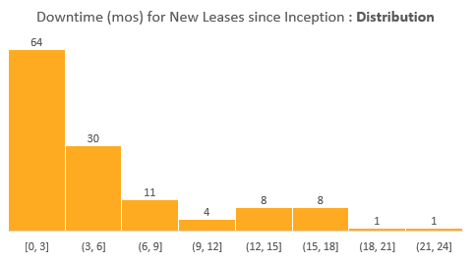
Portfolio Downtime since Inception | How is actual Downtime trending?
74% of signed new leases between signed since inception both the funds have a downtime < 6 months. This is in-line with the standard leasing assumption used in UW.
~22% of signed new leases since inception exceeded UW downtime.
39% of the leases that exceeded UW downtime occurred in the past year.
The data set represents ~127 new leases signed since inception.

Slide 30
Portfolio Downtime since Inception | How is actual Downtime trending?

Slide 31
Tenants Lost | Impact on Renewal Rate (Fund 2 & Fund 3)
The past quarter saw a total of 19 tenant move-outs across markets, varying in size ranges. Four of the move-outs were a result of a business closure/financial difficulty and one was the result of an eviction.

Slide 32
AR (Operational Overview)

Slide 33
Fund 2 | Tenant AR Summary
How are the tenants from Q4 trending?
Collections for Level 1 tenants have cleared up their 60+ day balance
Level 2 tenants have cleared up their 60+ balance driven by Bengal write-off
Level 4 tenants continue to accrue a balance, increasing from $1.2M to $1.47M, predominantly driven by TexPac (TX) & RPI (NJ)
Prior Level 4 tenants, Motorvation (GA) and Titan Solar (TX), have been removed and written-off
Level | Description
0 | Known Vacate
1 | Administrative
2 | Disputes
3 | Payment Plans/Watchlist
4 | Eviction / Past Tenant
New Activity emerging in Q1
4 new tenants added to the Level 4 default pool
3 tenants vacated at natural expiration, CCL Label, Jack Daniels & Webtech
Go Mini’s in Ohio assigned parking lease to Oras Express. December balance to be written off for month of transfer.​
4 new tenant added to the Level 3 payment plan pool
KJ’s Discount Outlet (Apollo TT) in Atlanta - TT occupies ~19K SF and hasn’t honored payment plan; demand notices sent
Aruvil International in New Jersey - TT occupies 30K SF and had an NSF in February,​ potentially due to Commercial Café, will monitor
Averr Aglow (Prior Level 2 Apollo TT) in Atlanta delinquent on personal property tax with county, will monitor
Black Walnut (Prior Level 4) has communicated they were awarded a new contract and will initiate back due payments

Slide 34
Fund 2 | Level 4 Tenants
Detail of Level 4 Tenants
Status​ | Property​ | Tenant​ | Credit Score | SF​ | In-Place Rent​ | Q4 24 Risk​ | Q1 25 Risk​ | 0-60 Days Balance​ | 60+ Days Balance​ | Notes​
Active​ | 4000 Dan Morton Dr (xtxmorto)​ | TexPac Hide & Skin, LTD (t0000522)​ |  | 77,536​ | $4.20​ | 4​ | 4​ | $148,353 | $461,917 | LL has possession; Lawsuit filed and TT countersued LL. Mediation scheduled for March 18th. Continuing billings per legal
Active​ | 220 Route 70 (xnj220r)​ | Simonik Transportation & Warehousing Group, LLC (t0001151)​ | 3 | 23,545​ | $8.75​ | 4 ​ | 4 ​ | $45,624 | $413,990 | Tenant filed for bankruptcy; Bankruptcy auction being held to remove remaining items and LL can then obtain possession of space.
Active​ | 220 Route 70 (xnj220r)​ | RPI Industries Inc. (t0000598)​ |  | 60,880​ | $6.97​ | 4 ​ | 4 ​ | $71,852 | $220,352 | Settlement being negotiated for $240K to be amortized into new lease. TT wants to downsize into Simonik ​space; TT paying monthly base rent in escrow. Escrow release received in January. Tied to Simonik bankruptcy
Past​ | 225 Bobrick Drive (xtn225bo)​ | Redeem Plastics LLC (t0001006)​ |  | 33,340​ | $4.76​ | 4 ​ | 4 ​ | $53,780 | $191,929 | Eviction successfully completed, AM working with legal to determine best course for potenatial collections.
Past​ | 1010 Old Egg Harbor (xnj1010) | Global Concentrate, INC. (t0000579) |  | 73489 | 5.19 | 4 | 4 | $84,468 | $128,960 | TT Vacated, Eviction Pending, AM working with tenant on settlement and TT offered $100K
Past​ | 19-05 Nevins Road (xnj19nev) | Jack Daniels Motors, Inc (t0000628) |  | 50591 | 8.11 | 0 | 4 | $64,472 | $9,077 | Lease expired EOY 2024;Colleciton anticipated
Past​ | 108 North Gold Drive (xnj108n) | Webtech, INC (t0000582) |  | 23912 | 7.77 | 1 | 4 | $3,554 | $31,224 | Moved out 1/31/2025; Security Deposit to be applied
Past​ | 2125 Vanco Drive (xtx2125v)​ | Titan Solar Power TX Inc (t0000719)​ |  | 26,532​ | $10.35​ | 4​ | 4​ | $18,639 | $3,160 | LL has possession; TT filed Bankruptcy payment received in 1Q25. Balance to be written-off.
Past​ | Multiple​ | Multiple (7 Tenants) ​ |  | ​ | ​ | 4​ | 4​ | $52,493 | $10,918 | All tenants have moved out. Most of the balance is a write-off recommendation​

Slide 35
Fund 2 | Level 3 Tenants
Detail of Level 3 Tenants
Status | Property | Tenant | Credit Score | Area | In-Place Rent | Q4 24 Risk | Q1 25 Risk | 0-60 Days Balance | 60+ Days Balance | Notes
Active​ | 128 Bauer Drive (xnj128ba)​ | Black Walnut LLC (t0001074)​ | 3 | 21,142​ | $13.75​ | 4 | 3 | $70,886 | $87,942 | FP has judgement, working with TT through payment plan to get current. Payment anticiapted late April/early May
Active | 17-01 Pollitt Drive (xnj17pol) | Biogen Laboratory Corporation (t0000629) |  | 8,438 | $9.50 | 3 | 3 | $15,335 | $21,639 | Habitual Late Payer; Late fees/TBB likely not collectable in 60+.
Active | 2100 Boggs Road (xga2100b) | Averr Aglow, LLC (t0000639) |  | 103,289 | $6.96 | 2 | 3 | $19,180 | $12,606 | Apollo TT; Delinquent on personal property tax with county; prior CAM Cap Dispute- they said they would pay; LL initiating default for tax delinquency
Active | 4450 Commerce Circle (xga4450c) | KJ's Discount Outlet LLC (t0001012) |  | 18,700 | $6.24 | 2 | 3 | $29,142 | $9,719 | Apollo TT; AM sending demand notice; TT requested payment plan but it wasn't honored
Active | 4290 Delp Street (xtndelp1) | KPower Global Logistics, LLC (t0000638) | 4 | 63,840 | $3.79 | 3 | 3 | $64,303 | $6,989 | Legal Engaged- Habitual late payer and legal needs to be engaged to collect multiple times. AM awaiting court date for potential eviction
Active | 4728 Goldfield Drive (xtxritti) | CJI Piping and Fabrication, LLC (t0000529) |  | 26,413 | $7.11 | 3 | 3 | $10,106 | $5,879 | January payment NSF'dl (3 NSFs in 2024); Payment plan ended and 60+balance is late fees, collection anticipated
Active | 2036 Briggs Road (xnj2036b) | Kaizen Martial Arts of NJ (t0000452) |  | 5,025 | $7.48 | 3 | 3 | $7,815 | $3,953 | CAM charges and late fees open in 60+ and collection anticipated through Security Deposit
Active | 6925 Sherman Ave (xnj6925s) | Aruvil International, Inc. (t0000784) |  | 30,000 | $5.78 | - | 3 | $4,823 | $693 | February payment NSF'd; issues with Commercial Café but monitoring
Active | 10501 King William Drive (xtx1050k) | AMG Stone Inc. (t0001056) | 3 | 6,635 | $9.36 | 3 | 3 | $5,982 | $0 | January payment NSF'd (3x in 2024) and was put in default again 2/18/2025. TT cured and payments received in April but monitoring due to history
Active | 19-05 Nevins (xnj19nev) | RD Foods America, Inc. (t0000627) | 5 | 151,799 | $15.25 |  | 3 | $457 | $0 | Potential TT softness identified; TT has one tenant utility charge open through 1Q25

Slide 36
AR Monitoring | Loan Pools
No Major Tenants are failing in Fund 2 Loan Pools from an AR perspective.
The Apollo Loan has 4 tenants that are being monitored and are currently not an issue
Averr Aglow (2100 Boggs) has been upgraded to a Level 3 tenant because they are delinquent on their county personal property tax, a defaulting event under the lease. Open CAM cap dispute and has agreed to but payment remains is pending
KJ's Discount Outlet LL (4450 Commerce) is currently not honoring their payment plan and demand notices have been sent
Motorvation (1157 Battlecreek), the largest balance in 4Q24 agreed to a termination agreement, paid $300K and vacated the property
Property | Market | Lease | Area | Q1 25 Tenant Risk | 0-60 Owed | 60+ Owed | Total Owed
2100 Boggs Road (xga2100b) | Atlanta | Averr Aglow, LLC (t0000639) | 103,289 | 3 | $19,180 | $12,606 | $31,786
4450 Commerce Drive (xga4450c) | Atlanta | KJ's Discount Outlet LLC (t0001012) | 18,700 | 3 | $29,142 | $9,719 | $38,861

Slide 37
Dispositions

Slide 38
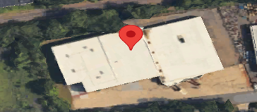
Disposition Case Study | 14 Morris Avenue | Maple Shade, NJ
OPEN –
AM
Well located functional building sold at a significant margin
An opportunity was presented to sell a highly functional, standalone warehouse in the densely populated Burlington County submarket to an Owner/User. The Buyer, Eastern Lift Truck Co.Inc, owns multiple neighboring assets and their strategic acquisition gave them controlling interest. Closing occurred on October 9h and the building was sold vacant.
During Faropoint's acquisition, the former Tenant, Carboline had occupied the facility for 20+ years until vacating August 31,2024. Following an internal rationalization process, Carboline elected to absorb this division into existing infill space within the market. The consolidation was into another facility owned by Carboline and approximately 0.3 miles away. With operations in over 90 countries, Carboline was a leading manufacturer of industrial grade coatings, linings and fireproofing.
The projected expense to reposition the asset, coupled with increased downtime projections and extensive deferred maintenance influenced the decision to contemplate a sale. Access to Morris Avenue is often restricted and a notable barrier for many prospects. Our low basis in the property achieved favorable return metrics
The appraised value as of June 30, 2024 was $5,200,000
Key Figures
Fund | Industrial Value Fund II
Investment Strategy | Value Add
Sourcing | Off Market
Acquisition Price | $2.4M ($59/SF)
Building Profile
Number of Buildings | 1
Size (SF) | 40,925
Number of Tenants | 1
Year Built | 1965/2000
Construction Type | CMU Block
Clear Height | 16'-29'4"
Dock Doors | 10
Drive-In’s | 2
Structural Office Area | 5%
 | Acquisition | Disposition
Date | 6/23/21 | 10/11/24
Price | $2,430,000 | $6,150,000
Occupancy | 100% | 0%
Rate ($/SF) | $3.99 | N/A
Term/WALT (Years) | 3.0 | N/A
Gross Levered IRR¹ | 21.3% | 46.2%
Net Levered IRR¹ | 17.1% | 38.7%
Gross Equity Multiple |  | 3.56
Net Equity Multiple |  | 3.01
“Gross IRR" represents target returns before Fund level fees, expenses and carried interest; "Net IRR” represents the annual compounded internal rate of return on a leveraged basis after deductions for management fees and carried interest based on a hypothetical liquidation of the property at the estimated net asset value (NAV). The calculations include theoretical distributions paid to limited partners at the property-level, as well as the estimated residual value of the limited partner’s investment (NAV after management fees and projected carried interest based on the estimated fair market value of the investment property determined in accordance with generally accepted accounting principles in the U.S.).
Note : Disposition IRR calculation applies 10% debt yield to T12 NOI (after subtracting $0.15 reserves PSF) to calculate leverage, with a maximum leverage of 60% against the sale price

Slide 39
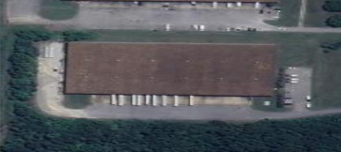
Disposition Case Study | 187 Bobrick | Jackson, TN
OPEN –
AM
Vacant building sold at a significant margin
An opportunity was presented to sell a highly functional, standalone warehouse in the Jackson, TN market to an Owner/User. The Buyer, Bobrick Water owns neighboring assets and their strategic acquisition provided the ability to expand their existing operation in the area. Closing occurred on October 25th and the building was sold vacant.
During Faropoint's acquisition, the former Tenant, EIS had occupied the entire facility vacating in May 1st of 2024. EIS was a low credit 3PL operating out of the facility with a single contract with UGN, and automotive parts supplier. Since acquisition, EIS was an AR watchlist tenant. Faropoint was able to bring EIS current before lease expiration. Additionally, EIS left UGN product in the facility after lease expiration. Faropoint was able to sign a 30 day access agreement with UGN above market while they relocated their assets.
Jackson, TN is the closest market to Ford's new EV manufacturing facility. When the facility was announced and during construction the market was met with significant demand of users looking to relocate near the facility. Ultimately Ford's delivery of the facility was delayed, causing softening in the market. The increased downtime projections influenced the decision to contemplate a sale.
The appraised value as of June 30, 2024 was $5,750,000
Key Figures
Fund | Industrial Value Fund II
Investment Strategy | Value Add
Sourcing | Off Market
Acquisition Price | $4M ($34/SF)
Building Profile
Number of Buildings | 1
Size (SF) | 120,000
Number of Tenants | 1
Year Built | 1998
Construction Type | Block & Metal
Clear Height | 28'
Dock Doors | 15
Drive-In’s | 1
Structural Office Area | 0%
 | Acquisition | Disposition
Date | 7/30/21 | 10/25/24
Price | $4,090,000 | $5,750,000
Occupancy | 100% | 0%
Rate ($/SF) | $2.25 | N/A
Term/WALT (Years) | 2.7 | N/A
Gross Levered IRR¹ | 17.0% | 32.1%
Net Levered IRR¹ | 13.2% | 25.6%
Gross Equity Multiple |  | 2.15
Net Equity Multiple |  | 1.88
“Gross IRR" represents target returns before Fund level fees, expenses and carried interest; "Net IRR” represents the annual compounded internal rate of return on a leveraged basis after deductions for management fees and carried interest based on a hypothetical liquidation of the property at the estimated net asset value (NAV). The calculations include theoretical distributions paid to limited partners at the property-level, as well as the estimated residual value of the limited partner’s investment (NAV after management fees and projected carried interest based on the estimated fair market value of the investment property determined in accordance with generally accepted accounting principles in the U.S.).
Note : Disposition IRR calculation applies 10% debt yield to T12 NOI (after subtracting $0.15 reserves PSF) to calculate leverage, with a maximum leverage of 60% against the sale price

Slide 40
Financial Overview

Slide 41
Balance Sheet
Key Takeaways
1
Fund Reserves
Fund Reserves = Net Current Assets + Credit Facility Availability
Q1 Results = Q1-25 Fund Reserves of $47.1M, a decrease of $3.9M from the Q4-24 Fund Reserves of $51.0M -> Mainly due Distribution of $ 4.6M.
Investment Property
FMV: as of Q1-25 is $1,252M (TC of $1,024M) - represents 22% unrealized appreciation
Dispositions: ITD -> 18 dispositions, $128.3M Net Sale Proceeds ($23.5M Capital Gain)
Q1 Appraisals: In Q1-25, 42 properties were appraised at $377.7M, compared to $371.3M book value, representing 2% in unrealized appreciation for this sub-set over book value ($6.4M)
A/R Tenants, Net
$1.2M A/R Tenants, Net of Allowances, as of Q1 2025 (see following slides for analysis)
Derivative Instruments
FMV of caps and swaps decreased $2.8M QoQ ($4.1M as of Q1-25 vs. $6.9M as of Q4-24)
Hedge Ratio = 98.3% as of end of Q1-> 86.3% pro-forma upon CAP expiration in April 2025
Loans, Net of Deferred Financing Costs
$489M loans ($376.5M KeyBank and $112.5M Apollo), less $3.2M of financing costs
Weighted Average Loan-to-Cost in Q1-2025 was 48.2% (48.3% in Q4)
KeyBank Revolver – final 12-month extension to be exercised in May (fully matures in 05/2026) – commitment to be reduced to $50M (from $150M)
Equity Upside
The change in NAV represents 43.8% upside on equity contributions ($500M)
2
1
3
2
3
4
4
5
5
*Note: Promote liability is presented as of Q4-24 balance, as the Q1-25 promote is not yet approved
Notes:
d

Slide 42
Balance Sheet
Key Takeaways
Fund Reserves
Fund Reserves = Net Current Assets + Credit Facility Availability
Q1 Results = Q1-25 Fund Reserves of $47.1M, a decrease of $3.9M from the Q4-24 Fund Reserves of $51.0M -> Mainly due Distribution of $ 4.6M.
Investment Property
FMV: as of Q1-25 is $1,252M (TC of $1,024M) - represents 22% unrealized appreciation
Dispositions: ITD -> 18 dispositions, $128.3M Net Sale Proceeds ($23.5M Capital Gain)
Q1 Appraisals: In Q1-25, 42 properties were appraised at $377.7M, compared to $371.3M book value, representing 2% in unrealized appreciation for this sub-set over book value ($6.4M)
A/R Tenants, Net
$1.2M A/R Tenants, Net of Allowances, as of Q1 2025 (see following slides for analysis)
Derivative Instruments
FMV of caps and swaps decreased $2.8M QoQ ($4.1M as of Q1-25 vs. $6.9M as of Q4-24)
Hedge Ratio = 98.3% as of end of Q1-> 86.3% pro-forma upon CAP expiration in April 2025
Loans, Net of Deferred Financing Costs
$489M loans ($376.5M KeyBank and $112.5M Apollo), less $3.2M of financing costs
Weighted Average Loan-to-Cost in Q1-2025 was 48.2% (48.3% in Q4)
KeyBank Revolver – final 12-month extension to be exercised in May (fully matures in 05/2026) – commitment to be reduced to $50M (from $150M)
Equity Upside
The change in NAV represents 43.8% upside on equity contributions ($500M)
1
1
2
3
2
3
4
4
5
5
*Note: Promote liability is presented as of Q4-24 balance, as the Q1-25 promote is not yet approved
Notes:
d

Slide 43
Profit and Loss
Key Takeaways
Net Operating Income
Decrease of $300K in NOI during the quarter (as projected based on budget)
Overall, YoC has decreased to 5.45% (compared to YoC of 5.55% in Q4-2024)
G&A:
G&A expenses were around ~60bps of equity, consistent with prior quarters
According to our projection, the expected 2025 run rate should be around ~75bps
Other One-Time Income, Net
Q1 2025 - $600K termination fee income, $300K insurance proceeds (3857 Miller Park)
Q4 2024 - $2.8M insurance proceeds (3857 Miller Park)
Change in Fair Value of Investment Property
42 Properties appraised, $6.3M MTM adjustment for the quarter for this sub-set
Prior Year Income (Expense)
~$410K income reversal due to over estimation of 2024 Cam Rec accrual
Interest Expense, Net
Base Interest Rate = 5.27% in Q1-2025, 5bp decrease from 5.32% in Q4-2024
Effective Base Interest Rate = 5.89% in Q1-2025, 6bp decrease from 5.95% in Q4-2024
*Adjusts for unused fees, financing and interest rate cap amortization costs, etc.
Hedge Ratio = 98.3%
Change in Fair Value of Derivative Instruments, Net
The value of the derivatives (FMV) rises and falls with the forward SOFR rate. Since Q4, the forward SOFR rate fell ~30bps due to the change in the forward curve.
$370M worth of contracts, average lifespan of 2 years left on the contracts
30bps x $370M x 2 years = ~$1.4M decrease
1
2
3
1
4
2
3
5
6
4
5
7
6
7
Notes:
Q1-2025
Termination Fee Income:
1211 Ford - $420K Northeast Building Products
19 Industrial - $135K OEM Accessories
1980 Old Cuthbert - $20K Ribbons Express
6704 N 54th Street - $110K Don’s Automotive Supply

Slide 44



Properties NOI Actuals vs. Budget
Key Takeaways
Net Operating Income (NOI)
Overall, Q1-2025 NOI aligns with the budget
Total Income
Total income is generally in line with the budget
Other Income
Includes $65K from a forfeited security deposit of a vacated tenant, as well as late and holdover fees
Operating Expenses (OpEx)
Slightly above budget due to $150K expected to be billed back from tenants, and approximately $150K of non-recoverable expenses (consideration needed for potential CapEx reclassification)
Bad Debt Expense
During the quarter, we recovered some previously recognized bad debt, which was not included in the budget
2
1
1
2
3
3
4
4
Budget column represents 2025 property-level budgets.
Actuals vs. Budget Analysis includes all properties of the Fund as of Q1-2025, excluding 6704 North 54th Street (acquired during Q4 2024).
$1,023M
WATC
Notes:
Q1 2025
Operating Expenses
Utilities
This variance is mainly due to a $200K tenant billbacks.
4290 Delp $69K for plumbing expenses
17-01 Pollitt Drive $41K in electric expenses.
220 NJ-70 $35k for multiple utility expenses.
Non-Recoverable Expenses:
Building R&M
3857 Miller Park Drive: property demolition ~$95K (Capex?)
Non-Recoverable
6000 Irwin Road: Fire Protection ~$46K

Slide 45
Same Store Analysis
Key Takeaways
Overall
Same Store NOI decreased ~$0.4M in Q1 2025, compared to Q4 2024
Operating Expenses
Operating expenses increased by $500K, primarily due to Snow Removal and Gas/Fuel costs, which combined for about $400K, which are cyclical.
Expense increases in line with Q1 budget
Bad Debt Expense
A number of collections of amounts that were previously written off were made during the quarter. The largest two amounts collected were from Greif and Motorvation for $200K and $300K, respectively
18 Railroad – additional $150k write-off in Q1 compared to Q4 provision
3 additional write-offs during Q – no provision
Non-Recurring Other Income (No Impact on NOI)
Current quarter the balance is primarily made up of $600K of termination fees
Prior quarter amount from insurance proceeds
1
1
2
2
3
Includes all properties of the Fund as of Q1-2025, excluding 6704 North 54th Street (acquired during Q4 2024).
3
Q4-2024 SS NOI is adjusted to reflected allocable fair share of the 2024 Cam Rec additional income.
*Note: Physical Occupancy adjusts for tenants who are in spaces but not currently paying prior quarters.
Notes:
Q1 2025: The positive Bad Debt Expense is due to collecting on previously written off tenants. The largest two collections are Greif and Motorvation
Xnj200ri This increase is following litigation to settle the disputed rent increase which was agreed upon and Greif subsequently resumed paying rent.
Xga1157 83K in bad debt , 300k settlement (Motorvation)
Xtx2125v 27K bad debt, no change in base rent recorded QoQ (Titan)

Slide 46
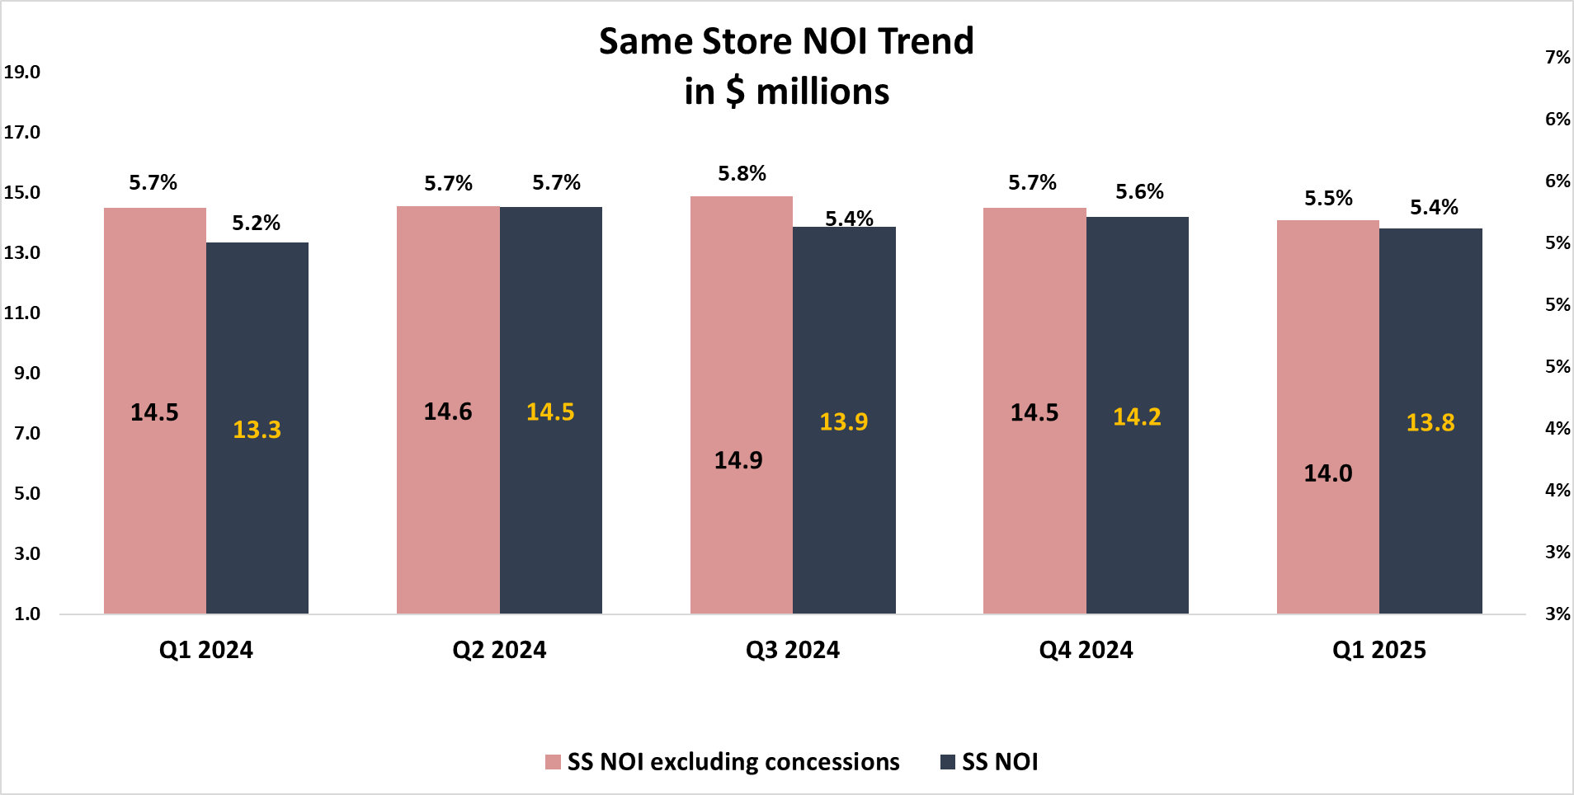
Same Store Analysis - QoQ Trend
Key Takeaways
We observe a similar trend of stagnation or slight decrease in Same-Store NOI and the run rate.
Conclusions
Negative net absorption, along with tenants going dark or not paying for various reasons, had a greater impact on NOI than the increase in base rent achieved through higher-than-projected leasing spreads on new leases.
Based on the diversification of tenant non-payment cases, we need to assess whether this trend is likely to repeat. It’s important to consider how to incorporate this risk into our future projections.
On the positive side, we can highlight that the SS NOI increased by 50 basis points from Q1 2024, despite the occupancy rate decreasing from 94.9% to 90.1%. This demonstrates our ability to unlock value from the leases we are executing.
Adj. Physical Occupancy*
94.9%
94.4%
92.4%
89.5%
88.3%
*Note:
Physical Occupancy adjusts for tenants who are in spaces but not currently paying prior quarters.
SSNOI was adjusted to reflected the fair share of the Cam Reconciliation for the period.

Slide 47
NOI to AFFO Analysis
Key Takeaways
Core FFO decreased this quarter to 3.1%, primarily driven by higher operating expenses dragging down NOI.
Core FFO was impacted by the following:
G&A
G&A expenses were around ~65bps of equity
According to our projection, the expected 2025 run rate should be around ~75bps
Prior Year (Expense)
*$400K correction of 2024 CAM Rec in Q1 2025
Payout Ratio for Distributions Analysis
According to the loan agreement we may include realized capital gains and exclude non-cash items such as financing cost amortization in the analysis
Feeder-Level Expenses
Defined as additional G&A expenses specifically allocable to feeder entities not reflected in Fund-level G&A (e.g., REIT Compliance, Cayman feeder regulatory compliance, etc.)
~10bps – ~20bps on equity / year
No impact to Core FFO, but will reduce the amount of distributable proceeds as costs will not be recouped until future periods
1
1
2
2
*Note: Prior quarters results were adjusted to reflected the fair share of the Cam Reconciliation for the period.

Slide 48
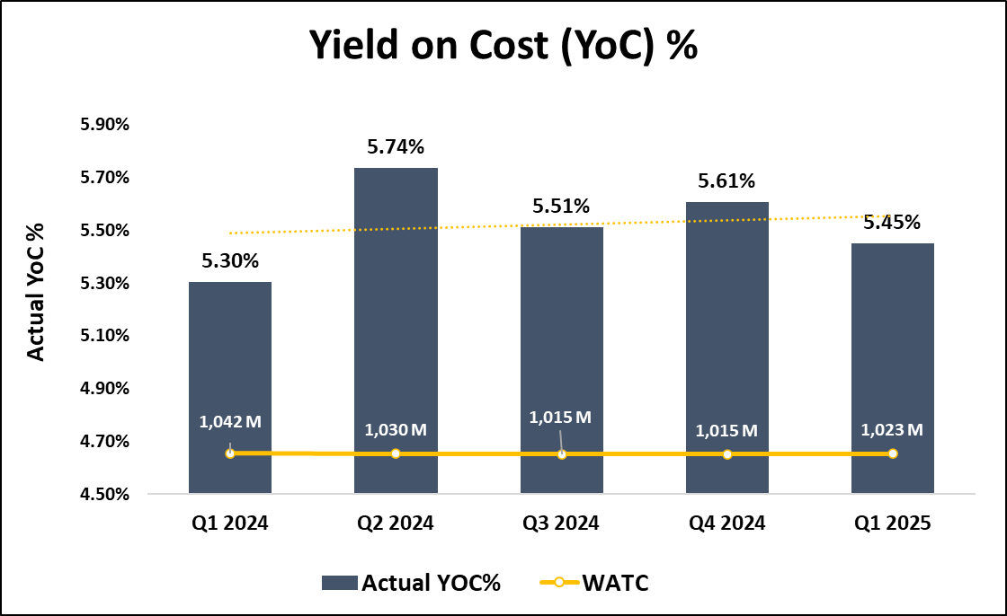
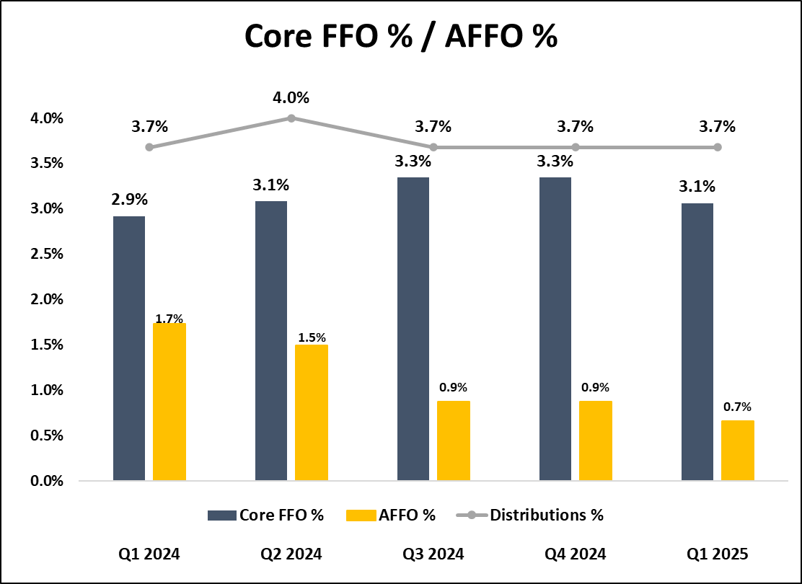
Fund Performance – Non-GAAP Financial Measures
Key Takeaways
Yield on Cost: 2024 figures reflect the 2024 CAM Rec Accrual and the latest Bad Debt Expense methodology Q4 2024 → Q1 2025 Trend: Yield on Cost (YoC%) decreased QoQ, reflecting 5.45% as of Q1-2025 compared to 5.61% as of Q4-2024 Core FFO decreased slightly QoQ, due to higher cyclical operating expenses (utilities, snow removal, etc.) in line with the budget, as well as ~$400K income reversal due to over estimation of 2024 CAM Rec accrual previously recognized | Forecasted Trends: As the Fund’s debt is either fixed or hedged at 98.3%, our interest rate risk exposure is essentially fully hedged as of Q1-25 We anticipate future property performance improvements to positively impact Core FFO Distributions in excess of Core FFO was funded through T12 capital gains. In order to keep distribution pace, additional dispositions are necessary
Prior quarters YoC%/FFO/AFFO was adjusted to reflected the fair share of the CAM Reconciliation for the period.

Slide 49
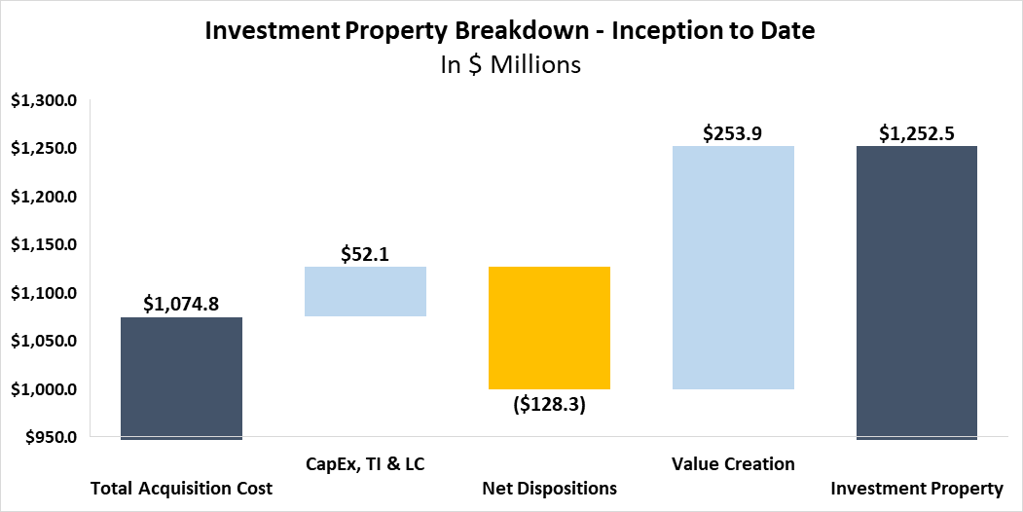
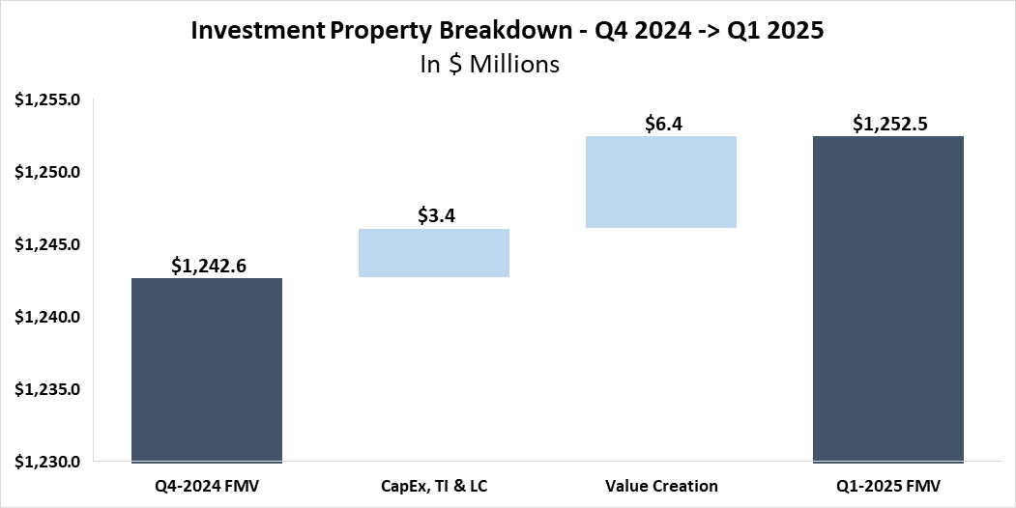
Valuation Summary – Q1 2025
Key Takeaways
Value creation inception to date has resulted in a +25.4% increase in fair market value vs. total cost (purchase price + closing costs + capex + dispositions) Since Inception, the fund has incurred a total of $13.7M in closing costs related to the acquisition of the properties. These closing costs have partially offset the overall value creation amount over the specified period All of the Fund’s properties were appraised at least once | During Q1-25, 42 properties were appraised for a total appraisal value of $377.7M The Q1-25 value creation of approximately $6.4M represents appraisal mark-to-market (representing 1.3% in unrealized appreciation for this sub-set over book value) 6704 N 54th Street – 1st time appraisal $4.2M MTM increase (+43% increase over Purchase Price)

Slide 50
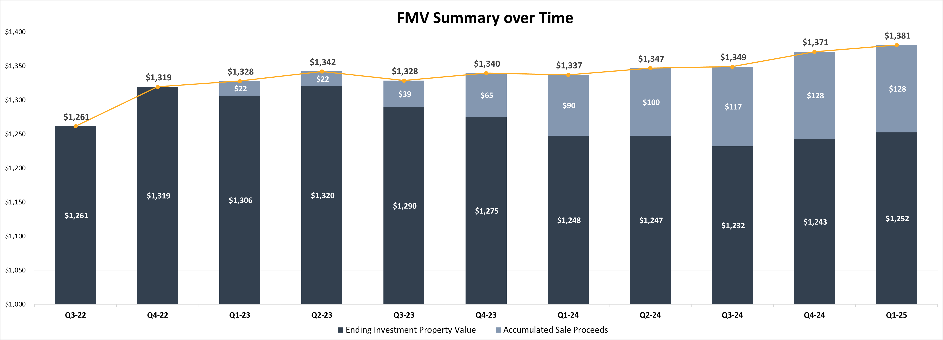
Valuation Summary – FMV Summary over Time ($M)

Slide 51
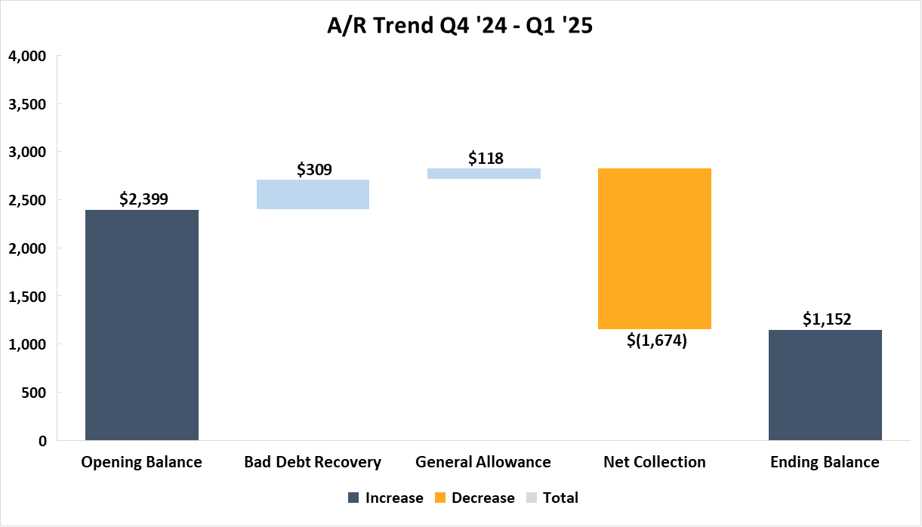
AR Trend Summary Q4 ‘24 -> Q1 ‘25
Key Takeaways
Net AR Balance decreased by $1,247K during Q1 2025
Bad Debt Recovery:
The Bad Debt Recovery is composed of Actual Write offs and specific bad debt allowance
18 Railroad –additional A/R write-off in Q1 compared to Q4 provision
Two highest AR collections netted ~$0.5M from 1157 Battlecreek (Motorvation) & 200 Rike (Greif)
General Allowance
Calculated in accordance with the General Allowance methodology, slight decrease in line with the overall decrease in AR balance QoQ
Net Collections
The total recognized revenue for the quarter was $1,438K less than the collections, primarily due to the CAM receivables collection. Additionally, during Q1, $400K of CAM receivables were reversed as part of the final billing to the tenants.
1
2
1
2
3
3
* As part of the technical billing cycle in Q1’25, $1.1M was recorded as revenue but later reversed as part of a specific bad debt allowance

Slide 52
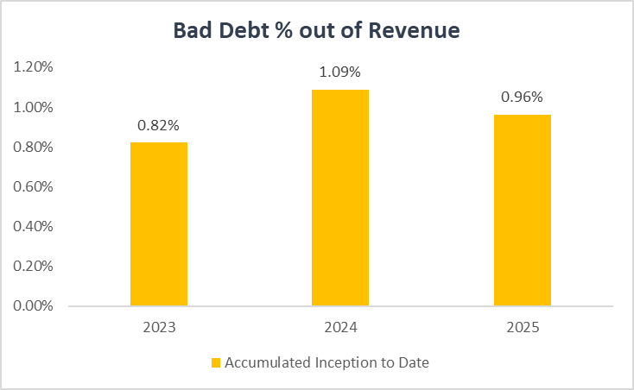
Bad Debt % out of Revenue
Key Takeaways
As of the end of Q1 2025 we have observed a decrease in bad debt from the peak in 2024. This is due to more collections on previously written off balances than in prior year and higher collection of written off balances than expected.
Historically, particularly in 2021 and 2022, there were instances where, instead of recording bad debt, revenue was reversed at the property level. The chart is based solely on the "bad debt expense" recorded in the books.”
Notes:
ITD -> accumulated; add comments to key takeaways

Slide 53
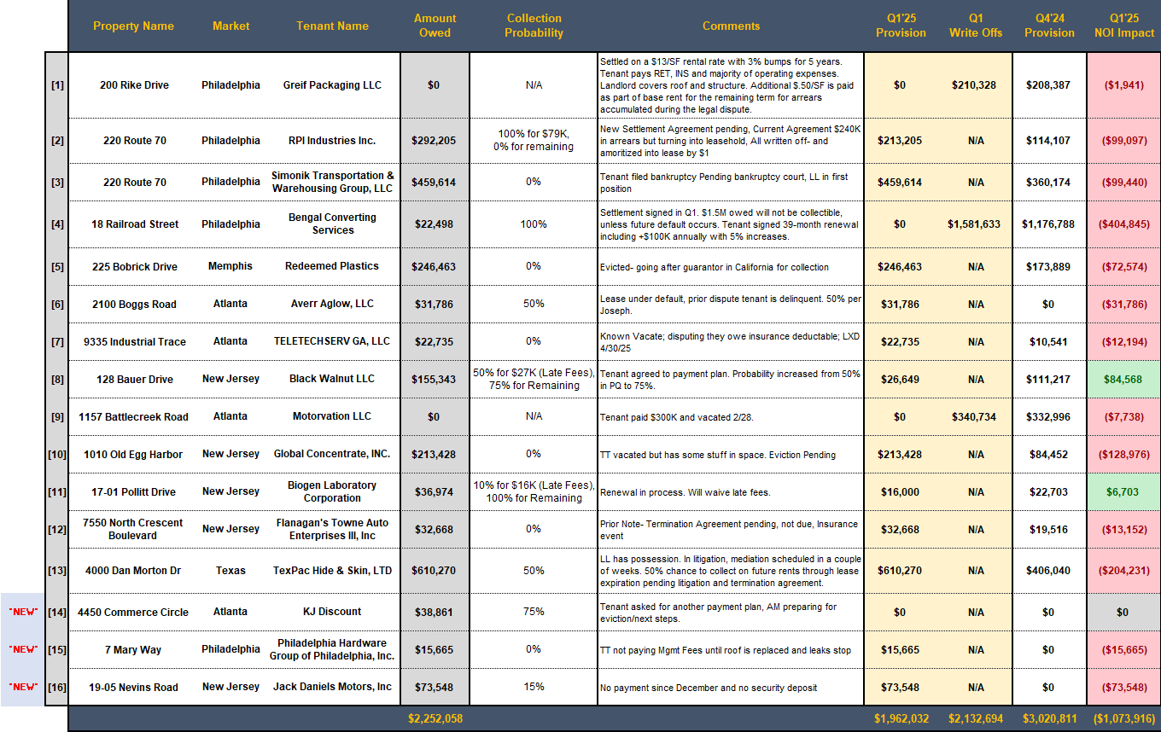
A/R Specific Allowance - Deep Dive

Slide 54
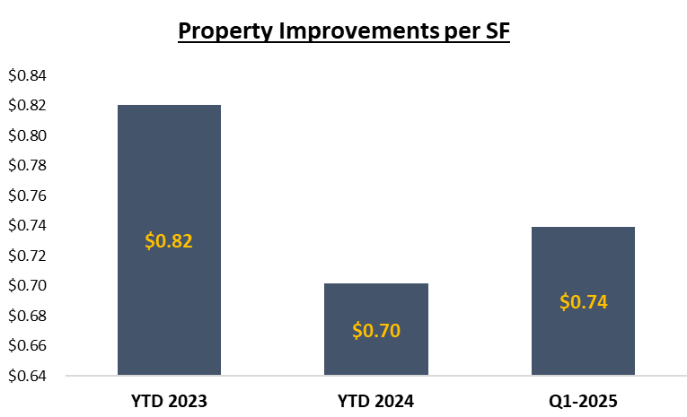
CAPEX, Tenants Improvements & Leasing Commissions
Key Takeaways
Q1 2025
Property Improvements of $1.9M in Q1-25
Represents 24.7% out of the Fund’s NOI and $0.74/SF for the quarter
Inception to Date
Inception to date the Fund has invested $54.3M in Property Improvements, TIs and LCs
***A reference point is missing to compare with business plan or relevant budgets – pending to work with AM/CM in 2025.
Property Improvements includes non-recoverable CapEx items + CM Fees
Turnover Costs represent the estimated obligations incurred in connection with the signing of a lease; including leasing commissions and tenant improvements
Property Improvements per Square Foot (SF) is calculated as Property Improvements for the quarter divided by the WASF (Weighted Average per Square Foot) for the period
Notes:
Add this analysis for Fund 2 (show how the capex is affecting the YOC despite the leasing spreads)

Slide 55
Main Debt Covenants Overview
Loan | Covenant | Threshold | NOI Basis | NOI Adjustments | Q1 2025 Metric | YoC % | Occupancy
Apollo | Debt Yield | 8.75%, 9.00%, 9.25% | T12 | 5% Vacancy / Credit Loss | 8.78% | 5.95% | 87.6%
KeyBank – Collateral Pool | Implied DSCR | 1.30x | T12 | $0.15 SF AR 60+ | 1.45x | 5.21% | 88.8%
KeyBank – Fund Level | FCCR | 1.50x | T12 | N/A | 1.85x | 5.34% | 88.6%

Slide 56
Distributions Considerations
Consideration | Decision Impact | Commentary
Consistency | Distribute 3-4% | We distributed $4.6M (3.7%) in each of the last 4 quarters We forecast Core FFO of $3.7M in Q1, $3.3M in Q2, and $4.0M in Q3 2025 After adding back financing costs amortization, this means $4.1M, $3.8M, and $4.6M available to distribute in the next 3 quarters respectively In order to maintain our $4.6M distribution, we will require additional capital gains from dispositions
Availability Forecast – Base Case vs Stress Test | Dependent on Disposition Plan | Even when assuming $4.6M (3.7%) distribution for this quarter, stress case debt availability remains at +$10M at the lowest point However, this is dependent upon executing the disposition plan
Payout Ratio | Dependent on Disposition Plan | We should be able to support the distribution from Payout Ratio perspective due to capital gain/other one time items that included in the Calculation.
Taxes (PIE) | Distribute 3-4% | In order to support shareholder loans (PIE), the fund needs to begin distributing 3-4% per quarter

Slide 57
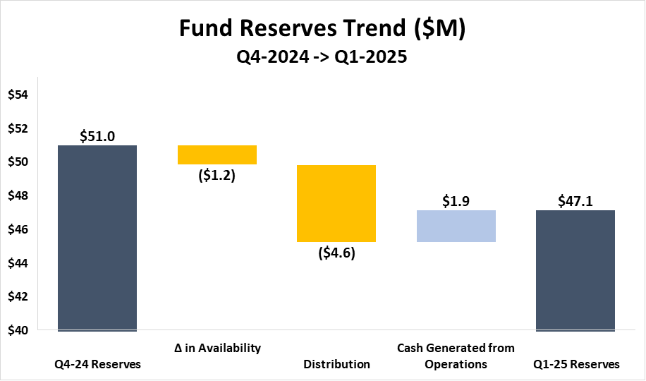
Fund Reserves
Key Takeaways
Fund Reserves = Net Current Assets + KeyBank Credit Facility Availability
Net Current Assets = Current Assets – Current Liabilities (including security deposit liabilities on leases coming due in <12 months)
Key Drivers Impacting Fund Reserves during the Quarter:
(-) 10Y Treasury Rate:
KeyBank Availability calculation models the Implied DSCR based on the T12 10-Year Average Treasury rate. As of Q1-2025, there was an 8-basis point (bp) increase in the trailing twelve-month (T12) 10-Year Average Treasury QoQ:
Q1 2025 T12 10YT Average = 4.28%
Q4 2024 T12 10YT Average = 4.20%
(-) Distributions:
$4.6 million distribution to investors during Q1 (3.7% Cash on Cash)
(+) Cash Flow Generated from Operations:
Includes $0.8M AFFO for Q1-2025, as well as additional cash collections in excess of billings for the quarter (bad debt recoveries, termination fee income, etc.).
It's important to note that most of the bad debt expenses for this quarter were already excluded from the availability calculation due to the loan agreement, which excludes AR +60 days.

Slide 58


Properties NOI Actuals vs. Budget – Apollo
Key Takeaways
Net Operating Income (NOI)
Overall, Q1-2025 NOI aligns with the budget
Total Income
Total income is generally in line with the budget
Non-Recoverable Expenses
5070 Minola - $8K Gas & Fuel overbudget
1157 Battlecreek$12K R&M unbudgeted
Various - $10K Roof Repair unbudgeted
Bad Debt Expense
During the quarter, we recovered some previously recognized bad debt, which was not included in the budget
1
2
3
Budget column represents 2025 property-level budgets.
$181M
WA Total Cost
29
Buildings
1.7M
SF

Slide 59
Effective Interest Rate
Return
CAP Amortization excluded from the P&L. Per IFRS, it is presented at its FV on the BS.
Amortization is the way to reflect the Cap acquisition cost in the Effective Interest Rate (EIR).
Our Hedging vehicles are proving effective, reducing the Fund’s EIR by ~86bps in Q1-25
~106bps reduction without non-cash CAP Amortization effect, (i.e., on a cash flow basis)

Slide 60
G&A Breakdown – Q1 2025
Key Takeaways
2025 G&A Run Rate is 75bps, excluding management fees & feeder expenses
Most expenses are non-controllable expenses
Audit Fees – based on 2025 engagement letter with KPMG
Tax Compliance Fees – based on 2025 engagement letter with EY
Administrator Fees – based on 2025 engagement letter with EA RESIG
Valuation Fees – based on 2025 engagement letter with JLL ($2K/appraisal)
Legal & Professional Fees – run rate based on historical data
Property-Level – collections litigation, lease negotiations, RE tax advisory, tenant credit checks, etc.
Yardi Software – per the annual agreement
Other Software – run rate based on historical data
Management Fees – run rate based on historical data
Feeder Expenses – run rate based on historical data (~10bps - ~20bps on equity)

Slide 61
Insurance Proceeds
Since the fund's inception, we have received over $7.0 million in insurance proceeds, impacting the financial statements and various KPIs as follows:
Audited Financial Statement: Proceeds Recorded as Revenue, Boosting Net Income |  | FPR: Proceeds Typically Excluded from Non-GAAP KPIs (FFO/NOI) |  | Key Bank Covenant Calculation: NOI Excluded, EBITDA Included
In the audited financial statement, insurance proceeds will increase both the fund's revenue and net income. As a reminder, Non-GAAP KPIs like NOI and FFO are not presented in the audited financial statements. |  | The internal KPIs are based on management's definitions and are not governed by IFRS or US GAAP. Since insurance proceeds are a one-time income, they will be excluded from FFO and NOI. However, in cases where the insurance compensates for loss of income, the relevant amount may be included in the non-GAAP KPIs, as determined by management. |  | Under the credit agreement definition, insurance proceeds are excluded from NOI in the Implied DSCR test for availability determination. However, per the credit facility agreement, insurance proceeds will be included in EBITDA ( which is used for FCCR Test )if they are part of net income in the audited financial statement (which applies here).
Revenue Recognition: Revenue from insurance proceeds will be recognized only when the amount is fixed or determinable, and collection is reasonably assured—typically estimated at a minimum of 80%. This requires that any contingencies related to the claim are resolved, with evidence from the insurer indicating either an intent to pay or an approval of the claim.

Slide 62
Termination Fee
Audited Financial Statement |  | FPR |  | KeyBank Covenant Calculation
Included in Net Income |  | Excluded from Non-GAAP KPIs (FFO/NOI) |  | Excluded in NOI, Included in EBITDA
In the audited financial statement, termination fees will increase both the fund's revenue and net income As a reminder, Non-GAAP KPIs like NOI and Core FFO are not presented in the audited financial statement |  | The internal KPIs are based on management's definitions and are not governed by IFRS or US GAAP Since termination fees are a one-time income, they will be excluded from Core FFO and NOI However, in cases where the termination fee compensates for loss of income, the relevant amount may be included in the non-GAAP KPIs, as determined by management |  | Under the credit agreement definition, termination fees are excluded from NOI in the Implied DSCR test for availability determination However, per the credit facility agreement, termination fees will be included in Consolidated EBITDA (base for FCCR Test) since the fees are recognized as revenues included in net income in the audited financial statements

Slide 63
Fund Forecast

Slide 64
Full Fund Forecast

Slide 65
Fund Forecast | Overview of Fund Timeline
Key Takeaways
The Fund Initial Closing was in April 2021 with an initial fund term of 6 years with two 12-month extensions (6+1+1)
The Fund is currently in the market for a ~$308M Refinance of 61 Properties expected to close in July
We are here
May ’26
Revolver Expires ($150M Committed)
Dec ’26
TL A Expires ($110M)
Jun ’27
TL B Expires ($267.5M)
Feb ‘28
Feb ‘29
Apollo Loan Open ($112.5M)
Dec ‘21
Dec ‘22
Dec ‘23
Dec ‘24
Dec ‘25
Dec ‘26
Dec ‘27
Dec ‘28
Apr ‘21
Apr ‘24
Oct ‘24
Apr ‘25
Apr ‘27
Apr ‘28
Apr ‘29
Initial
Close
End of 3 Year Inv. Period
+6 Months Extension
+6 Months Extension
End of 6 Year
Fund Term
+1 Year
Extension
+1 Year
Extension

Slide 66
Fund Forecast | Identified Dispositions
Key Takeaways
There have been 18 dispositions in the fund to date, with a total sales price of ~$132.3M
The model assumes 12 dispositions in 2025 totaling ~$68.8M of sales price, largely misfits with quality or location issues
The Investments Team has identified an additional 12 assets for disposition in 2026 and on, those are not modeled here
Forecasted Dispositions
Actual & Forecasted Dispositions
Asset Name | Area (SF) | Sales Price | Disposition Date
420 Benigno Boulevard | 53.1k | $7.1M | 5/31/2025
440 Benigno Boulevard | 42.9k | $5.7M | 5/31/2025
900 Kennedy Boulevard | 41.5k | $6.4M | 5/31/2025
6900 River Road | 22.7k | $3.1M | 6/30/2025
1211 Ford Road | 106.0k | $12.5M | 7/31/2025
3350 Hamilton Boulevard | 86.5k | $8.1M | 7/31/2025
4728 Goldfield Drive | 77.7k | $10.1M | 7/31/2025
1000 E 87th St* | 34.3k | $2.1M | 8/31/2025
3040 - 3050 E 14th Avenue | 11.5k | $1.3M | 10/31/2025
3045 - 3065 Switzer Avenue | 17.9k | $2.1M | 10/31/2025
1149 - 1161 Rarig Avenue | 28.8k | $3.3M | 11/30/2025
3000 - 3004 E 14th Avenue | 61.9k | $7.1M | 11/30/2025
Total | 585.8K SF | $68.8M
Period | Sales Price | Area (SF)
Inception to Date | $132.3M | 1.6M SF
Q2 2025 | $22.3M | 160.2K SF
Q3 2025 | $32.7M | 304.6K SF
Q4 2025 | $13.8M | 120.1K SF
Total | $201.1M | 2.2M SF
*Sale Price derived from Q1 2025 FMV

Slide 67
Fund Forecast | Yield on Cost Trends
Key Takeaways
Significant increase to yield on cost projected throughout 2026 and 2027
Projections below reflect an adjusted NOI factoring in a bad debt assumption of 2% in 2025 and 5% in 2026 & 2027
Projections below reflect Forecast Manager (FM) book closed in April 2024

Slide 68
Fund Forecast | Capex, TI & LC Trends ($M)
Key Takeaways
CapEx fluctuates over time, with it peaking in 2026 at $20.8M
Accumulated CapEx and TI/LC reach ~$112.9M for the fund by the end of 2027

Slide 69
Loan & Hedging Maturities
Floating
Executed Hedging
Loan Term
Floating
$11.5M
4.3% + 2% = 6.3%
Hedging Overview
Cap
$140M
3.0% + 2% = 5%
Mar ‘22
Apr ‘25
Swap
$150M
2.74% + 2% = 4.74%
May ‘22
Dec ‘26
Expired 4/16/25
Swap
$50M
2.92% + 2% = 4.92%
Jun ‘22
Dec ‘26
Swap
$30M
3.60% + 2% = 5.60%
Mar ‘23
Jun ‘27
Fwd Swap
$95M
3.26% + 2% = 5.26%
Apr ‘25
Jun ‘27
Apollo
$112M
Feb ‘24
Feb ‘29
Term Loan B
$267M
Jun ‘22
Jun ‘27
Credit Facility Term Overview
Avg. of ~200bps spread
Term Loan A
$104M
Dec ‘21
Dec ’26
Revolver
$150M
$5M Outstanding
May ‘21
+1
+1
May ‘26
Dec ‘21
Dec ‘22
Dec ‘23
Dec ‘24
Dec ‘25
Dec ‘26
Dec ‘27
We are here – April ‘25

Slide 70
Fund Forecast | Hedging Overview
Key Takeaways
In Q1 2025, our weighted average hedging was 97.8%
We closed on a $112.5M loan with Apollo at an all-in rate of 6.04% in February
We already have $95M of forward swaps in place to account for the expiration of the $140M cap in April 2025
To maintain REIT compliance, $20M of a swap was sold in September 2024 to prevent fund from being over hedged after recent property dispositions
The forecasts here factor in the property disposition plan for 2025
$200M in swaps expire 12/16/26
$20M swap sold Q3-24
$140M cap expired 4/16/25
Note: All-in interest rates and % hedged graphs represent weighted averages throughout each year
SOFR forward curve taken as of 4/21/2025

Slide 71
Fund Forecast | Effective Hedging Analysis
Dec 2026:
$104M TL A Expires
Jun 2027:
$267M TL B
Expires
Key Takeaways
We are tracking to be above our hedging target in each quarter until Q1 2027 when $200M in swaps expire
We already have $95M of forward swaps in place to account for the expiration of the $140M cap in April 2025
The hedging trend remains above 90% throughout 2025 as the cap expiration is offset by $68.8M of dispositions and the $95M in forward swaps commencing
May 2026: Revolver Expires
$140M cap expired 4/16/25
$200M in swaps expire 12/16/26
In-Place Hedging | Type | Amount | Rate | Start Qtr | End Qtr
$112.5M Apollo Refi – 5 Yr | Refi | $112.5 | 3.94% | Q1 2024 | Q1 2029
$140M Cap - 3 Yr | Cap | $140 | 3.00% | Q2 2022 | Q1 2025
$150M Swap - 5 Yr | Swap | $150 | 2.74% | Q2 2022 | Q4 2026
$50M Swap - 5 Yr | Swap | $50 | 2.92% | Q2 2022 | Q4 2026
$50M Swap - 4.25 Yr | Swap | $30 | 3.60% | Q1 2023 | Q2 2027
$50M Fwd Swap - 2.13 Yr | Swap | $50 | 2.79% | Q2 2025 | Q2 2027
$15M Fwd Swap - 2.13 Yr | Swap | $15 | 4.26% | Q2 2025 | Q2 2027
$15M Fwd Swap - 2.13 Yr | Swap | $15 | 3.80% | Q2 2025 | Q2 2027
$15M Fwd Swap - 2.13 Yr | Swap | $15 | 3.29% | Q2 2025 | Q2 2027

Slide 72
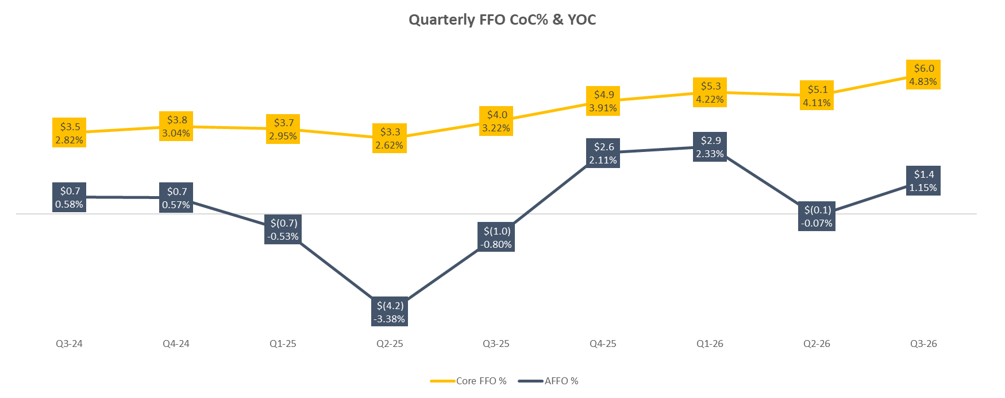
Fund Performance Overview | Quarterly FFO & AFFO Forecast
OPEN –
Corp Finance
Key Takeaways
Gap between FFO and AFFO is largest in Q1 through Q3 2025 due to high CapEx, TI & LC in these quarters
The AFFO is at lowest in Q2 2025 due to $8M of CapEx, TI & LCs occurring in this quarter alone

Slide 73
Financing Strategy & Summary| $308M Refi
Key Takeaways
The fund is actively in the market for refinance of 61 assets totaling 3.5M SF and is expecting proceeds of ~$308M
Once the refi is closed the fund plans to pay off the $104M Term Loan A, Term Loan B down from $267.5M to $100M and keep $50M commitments on the revolver (to be extended May 26’) to fund future CapEx, TI, and LCs
Refinance
Pool Metrics | Area (SF) | 3.45M SF
 | Number of Assets | 61 Assets
 | FMV¹ | $462.7M
 | Total Cost¹ | $355.3M
Loan Proceeds | Loan Amount² | $308M
 | Loan-to-Cost¹ | 86.7%
Interest Rate | Interest Rate | 4.50% Cap (1-Month SOFR)
 | Spread | 2.00%
 | All-In Rate | N/A
 | Interest Only | Full Term
 | Origination & Upfront Fee | Est. 250bps (100 bps orgination,40-50bps broker,50-60bps legal & other plus $1.5M Cap Cost)
Credit Facility Commitments
Loan | Before Refi | After Refi
Term Loan A | $104M | Paid Off
Term Loan B | $267.5M | $100M
Revolver | $150M | $50M
Metrics as of 3/31/2025
$308M loan is the estimate provided by the CBRE debt team sizing off an 8.0% Debt Yield

Slide 74
Fund Performance Overview | Quarterly FFO & AFFO Forecast
Key Takeaways
If we complete the partial refi of the stabilized pool, the FFO decreases by $1.0-1.5M per quarter due to the higher debt balance of the fund after the refi
AFFO will be negative until Q4 2026 in the scenario where we complete the partial refi
Identified Dispositions & No Refi
Identified Dispositions & $308M Refi

Slide 75
Fund Performance Overview | Distribution Forecast
Key Takeaways
If we complete the stabilized pool refi in Q3 2025, we expect to be able to distribute $75M of surplus proceeds to investors
In this case, we assume that after the refi we are able to maintain Core FFO distributions by funding Capex, TI & LC of all properties through the NOI growth of the unstabilized credit facility pool
Identified Dispositions & No Refi
Identified Dispositions & $308M Refi

Slide 76
Fund Performance Overview | IRR Forecast
Key Takeaways
IRR and equity multiple calculations assume fund is sold at the end of 2027 (i.e., Jan 1, 2028) and factor in all side letters
When factoring in the pending dispositions, the total sale price of the fund is ~$1.40B at the base case 5.85% exit cap
The partial refi boosts the IRR by ~10bps by allowing us to distribute proceeds back earlier but also allowing us to maintain distributions by keeping the revolver
Identified Dispositions & No Refi
End of Year 2028 Sale
Disposition Cap Rate | Gross IRR | Net IRR | Gross EM | Net EM | GP Promote | Sale Price | Total Pre-Fund Sale Dispositions
5.50% | 14.73% | 11.90% | 2.16x | 1.91x | $66.7 | $1,419.0 | $201.1 ($68.8 Pipeline)
5.75% | 13.59% | 10.98% | 2.03x | 1.82x | $52.6 | $1,357.3
5.85% | 13.15% | 10.58% | 1.99x | 1.78x | $49.2 | $1,334.1
6.00% | 12.49% | 9.98% | 1.92x | 1.73x | $45.1 | $1,300.7
6.25% | 11.42% | 9.03% | 1.82x | 1.64x | $37.3 | $1,248.7
Identified Dispositions & $308M Refi
End of Year 2028 Sale
Disposition Cap Rate | Gross IRR | Net IRR | Gross EM | Net EM | GP Promote | Sale Price | Total Pre-Fund Sale Dispositions
5.50% | 14.90% | 12.01% | 2.12x | 1.88x | $65.4 | $1,419.0 | $201.1 ($68.8 Pipeline)
5.75% | 13.73% | 11.06% | 2.00x | 1.79x | $51.4 | $1,357.3
5.85% | 13.27% | 10.66% | 1.95x | 1.75x | $47.4 | $1,334.1
6.00% | 12.59% | 10.03% | 1.89x | 1.70x | $43.3 | $1,300.7
6.25% | 11.49% | 9.04% | 1.79x | 1.61x | $35.6 | $1,248.7

Slide 77
Fund Forecast | Debt Covenants
Key Takeaways
Once the T12 expense fully reflects the impact of the $308M refi, the FCCR is expected to bottom out at 1.54x, leaving a 0.04x buffer with the 1.50x covenant. This is due to ~$90M incremental loan proceeds at ~6.0% interest rate
It is recommended that the we approach KeyBank to lower or remove the covenant if we continue with the refinance
The higher debt service from the $308M refi is projected increase the T-12 finance expense from $24.1M to $29.6M in Q2 2026

Slide 78
Debt Availability and Distribution Forecast

Slide 79
Debt Availability Forecast | Previous to Current Comparison
OPEN –
Corp Finance
Key Takeaways
Our current availability forecast is generally in line with where we were at the end of last quarter
However, compared to the debt availability forecast used to sign-off $70M new acquisitions in the fund, the current forecast projects significantly less availability
In September, the SOFR forward curve projected the 10Y Treasury at ~3.75% for 2025, compared to ~4.10% now. This increase reduced stress case reserves by ~$15M
In addition, ~$2.5M reduction to FM NOI for FY 2025 further reduced the availability forecast by $20-25M
Notes:
Due to loss of sales being removed from loan balance and also t-12 NOI drop

Slide 80
Debt Availability Forecast | Base Case
No Dispos
Key Takeaways
We project to project to be in compliance with the DSCR covenant in all quarters with no dispositions in the base case scenario
This assumes that we freeze distributions starting next quarter until Q2 2026
Assumes that all assets not sold and not in the Apollo pool are included in the credit facility calculation. The pending Apollo asset swap is reflected here
The graphs to the left use the current 4.4% 10Y Treasury forward curve as 4/21/2025

Slide 81
Debt Availability Forecast | Stress Test
No Dispos
Key Takeaways
This scenario applies 50bps increase to the 10Y Treasury and 5% decrease to projected NOI
In the stress test scenario, we fall out of compliance in Q4 2025 through Q2 2026, even when pausing distributions
Assumes that all assets not sold and not in the Apollo pool are included in the credit facility calculation. The pending Apollo asset swap is reflected here
The graphs to the left use the current 4.4% 10Y Treasury forward curve as 4/21/2025 per our 50bps stress test methodology

Slide 82
Debt Availability Forecast | Base Case
With Dispos
Key Takeaways
We project to be in compliance with the DSCR covenant throughout 2025 and 2026 after the disposition of $68.8M of assets through out 2025
With the dispositions we project Q4 2025 and Q1 2026 debt reserves of $65.1M and $60.0M respectively
Assumes that all assets not sold and not in the Apollo pool are included in the credit facility calculation. The pending Apollo asset swap is reflected here
The graphs to the left use the current 4.4% 10Y Treasury forward curve as 4/21/2025

Slide 83
Debt Availability Forecast | Stress Test
With Dispos
Key Takeaways
This scenario applies 50bps increase to the 10Y Treasury and 5% decrease to projected NOI
In the stress test scenario, we stay in compliance with the DSCR Covenant for the remaining life of the fund
Debt reserves are projected to be at the lowest level in Q1 2026 at $23.8M
Assumes that all assets not sold and not in the Apollo pool are included in the credit facility calculation. The pending Apollo asset swap is reflected here
The graphs to the left use the current 4.4% 10Y Treasury forward curve as 4/21/2025 per our 50bps stress test methodology

Slide 84
Debt Availability Forecast | Fund Reserves
With Dispos
Key Takeaways
When factoring in $2.7M of Net Current Assets, the total Fund Reserves reach a stress case minimum of $26.5M in Q1 2026
In addition, reserves are boosted by $43.5M from the planned asset dispositions throughout 2025

Slide 85
Refi IRR Deep Dive

Slide 86
Refi Impact Analysis | Incremental Cashflow
Key Takeaways
Without refi, we can maintain average $5.5M distributions per quarter, or $22M per year
The refi has $10M closing costs plus additional $35M interest expense
The cost of the $230M upfront distribution is $22M per year, or 9.7% return. Since the fund is at 10.6% IRR, the benefit of refi is only 0.9% for 2.5 of 7 years, or 20bps on IRR

Slide 87
Apollo Refi | Debt Yield Covenant Analysis
OPEN –
Corp Finance
Key Takeaways
Apollo DY covenant was only slightly above the threshold in Q1 due to the $670k write off from Spartan Equity and $190k from Ashanti Films
The DY threshold steps up from an 8.75% to 9.00% DY in Q1 2026
DY NOI cushion is forecasted stay around $0.4M until Q1 2025 when it will start to steadily increase by $0.3-$0.4M per quarter throughout 2025

Slide 88
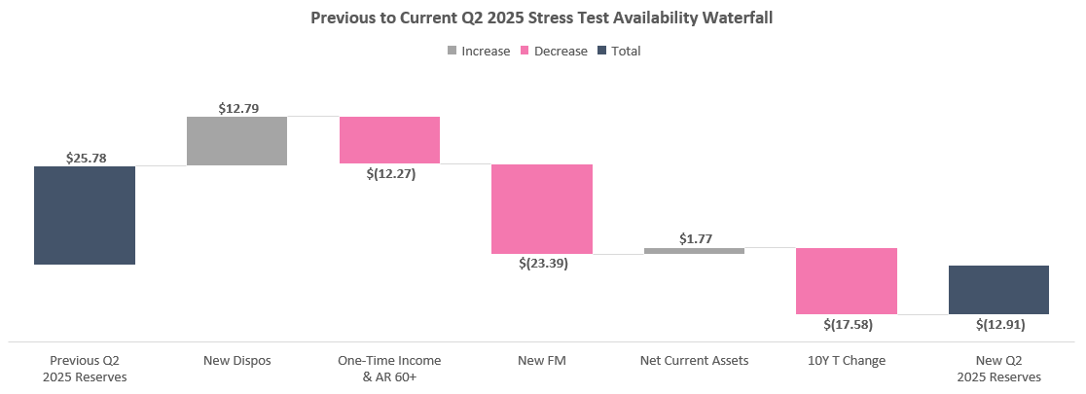
Debt Availability Forecast | Previous to Current Q2 2025 Stress Test Waterfall
OPEN –
Corp Finance
Key Takeaways
4 dispositions added to the model (7903 Webbles, 3333 N Canal, 187 Bobrick, 225 Bobrick) for ~$20M sale proceeds created +$13M net availability boost
Increase from $1.44M to $2.80M One-Time Income & A/R 60+ adjustment, creating ($12M) change to availability
($2.8M) change to T12 stress test NOI in Q2 2025 due to change from previous to new FM
50bps increase to Treasury forward curve (from 4.1% to 4.6%) created ($18M) decrease to debt availability

Slide 89
Apollo Forecast

Slide 90
Apollo Forecast | Yield on Cost Trends
Update - Corp Fin
OPEN –
Corp Finance
Key Takeaways
Significant increase to yield on cost projected throughout 2026 and 2027
Projections below reflect unadjusted Forecast Manager NOI before factoring in any bad debt assumption (although 2% bad debt is applied to cashflows for IRR)
Projections below reflect Forecast Manager (FM) book closed in January 2025

Slide 91
Apollo Forecast | Capex, TI & LC Trends ($M)
Update - Corp Fin
OPEN –
Corp Finance
Key Takeaways
CapEx fluctuates over time, with peak years in 2024 and 2026
Accumulated CapEx and TI/LC reach ~$96.0M for the seed portfolio by the end of 2028

Slide 92
Apollo Forecast | Debt Covenant Analysis
Update - Corp Fin
OPEN –
Corp Finance
Key Takeaways
The Debt Yield Covenant increases from 8.75% to 9.00% in Q4 2025 and to 9.25% Q4 2027
Due to downtime and concessions in 2026, we see a reduction in the DY to 9.66% in Q3 2026 (still above 9.0% covenant)
An additional 5% vacancy/credit loss factor is applied to T12 NOI in all quarters to be conservative, regardless of actual vacancy
Debt Yield Covenant uses T12 NOI for calculation

Slide 93
Credit Facility Forecast

Slide 94
Credit Facility Forecast | Yield on Cost Trends
Update - Corp Fin
OPEN –
Corp Finance
Key Takeaways
Significant increase to yield on cost projected throughout 2026 and 2027
Projections below reflect unadjusted Forecast Manager NOI before factoring in any bad debt assumption (although 2% bad debt is applied to cashflows for IRR)
Projections below reflect Forecast Manager (FM) book closed in January 2025

Slide 95
Credit Facility Forecast | Capex, TI & LC Trends ($M)
Update - Corp Fin
OPEN –
Corp Finance
Key Takeaways
CapEx fluctuates over time, with peak years in 2024 and 2026
Accumulated CapEx and TI/LC reach ~$96.0M for the seed portfolio by the end of 2028

Slide 96
Appendix

Slide 97
Definitions (Continued)
Net Operating Income (NOI) Net Operating Income (“NOI”) is a supplemental non-generally accepted accounting principles (“GAAP”) measure of our property operating results that we believe is meaningful because it enables management to evaluate the impact of occupancy, rents, leasing activity and other controllable property operating results at our real estate. We define NOI as operating revenues less operating expenses, which exclude (i) impairment of investments in real estate, (ii) depreciation and amortization, (iii) straight-line rental income and expense, (iv) amortization of above- and below-market lease intangibles, (v) lease termination fees, (vi) property expenses not core to the operations of such properties, and (vii) other non-property related revenue and expense items such as (a) general and administrative expenses, (b) management fee paid to the Adviser, (c) performance participation allocation paid to the Special Limited Partner, (d) incentive compensation awards, (e) income (loss) from investments in real estate debt, (f) change in net assets of consolidated securitization vehicles, (g) income from interest rate derivatives, (h) net gain (loss) on dispositions of real estate, (i) interest expense, (j) gain (loss) on extinguishment of debt, and (k) other income (expense).
Project Cost The amount of cash or cash equivalents paid or the fair value of the other consideration given to acquire an asset at the time of its acquisition or construction, or, when applicable, the amount attributed to that asset. (Including Capex (General Building Improvement, Tenant Improvement and Leasing commission)
Yield on Cost (YoC) % Yield on cost measures income in relation to the total cost of the property. YOC% is calculated as a property's Net Operating Income (NOI) divided by the total project cost.
Same Store NOI We evaluate the performance of the operating properties we own and manage using a “same store” analysis because the population of properties in this analysis is consistent from period to period.

Slide 98
Definitions (Continued)
Funds from Operations (FFO) We define FFO in accordance with the standards established by the National Association of Real Estate Investment Trusts (“NAREIT”). FFO represents net income (loss) (computed in accordance with GAAP), excluding gains (or losses) from sales of depreciable operating property, gains (losses) from sales of land, impairment write-downs of depreciable real estate, real estate related depreciation and amortization (excluding amortization of deferred financing costs and fair market value of debt adjustment) and after adjustments for unconsolidated partnerships and joint ventures.
Core FFO Core FFO excludes transaction costs and non-recurring other expenses.
AFFO To arrive at AFFO, we adjust Core FFO to include realized gains from the disposition of land and development properties, net of current tax expense, and recurring capital expenditures and exclude the following items that we recognize directly in Core FFO: straight-line rents; amortization of above- and below-market lease intangibles; amortization of management contracts; amortization of debt premiums and discounts and financing costs, net of amounts capitalized, and; stock compensation amortization expense.
Base Interest Rate The actual interest that was paid during the period. Effective Interest Rate (w/o Origination Fee Amortization) Base Interest Rate + Amortization of Hedging Costs. Effective Interest Rate Base Interest Rate + Hedging Costs + Origination Fee Amortization
Recovery Ratio Recoveries Income/Recoverable and Non-Recoverable Expenses. This KPI will be used to measure our ability to collect recoveries from tenants.

Slide 99
Definitions (Continued)
Leasing Spread Rent increase of signed leases over prior lease annual base rent PSF expressed in NNN terms, excluding vacant spaces.
Economic Occupancy Net Base Rent received after deduction of free rent and income lost due to vacancy expressed as a percentage of maximum potential rent.
Transaction NOI Monthly contractual income annualized less YTD recoverable and non-recoverable expenses and remaining budget for recoverable and non-recoverable expenses. Income Adjustments include One-time accounts such as Concessions, Prior Year Income, Bad Debt, Insurance Income, Late fees, Termination fees, Holdover fees and Security Deposit.
Net Income from Downtime Annualized income from lease commencements during period less pro-rata income during period from expiring leases. Net Absorption Sum of square feet that became physically occupied, minus the sum of square feet that became physically vacant during a specific period. Total Lease Value Base Annual Rent contracted over the lease term excluding OpEx. CTV (Cost to Value) TI, LC and FR​ as a % of Total Lease Value. Capex is not included in the calculation.

Slide 100
Same Store Analysis - Apollo
Ready for Review –
Fund Finance
$180M (16.9%)
WA Total Cost
29
Buildings
1.7M (16.3%)
SF

Slide 101
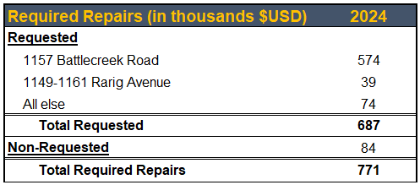
Escrows: Required Repairs- Apollo
OPEN –
Fund Finance
Key Takeaways
2024 Required Repairs Release

Slide 102
KeyBank Q4 2024 Compliance – Quarterly Availability Trend Analysis

Slide 103
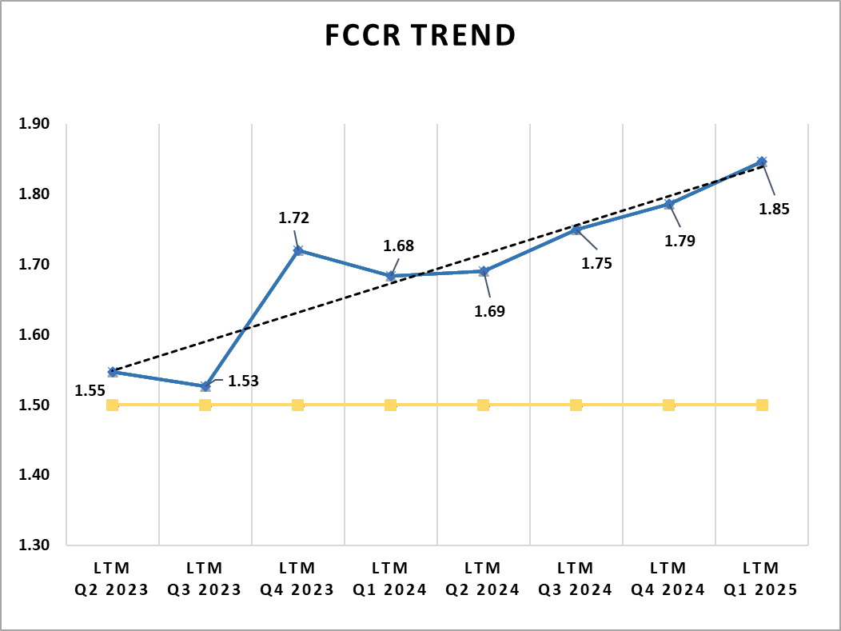
KeyBank Q1 2025 Compliance - FCCR
Key Takeaways
Fixed Charge Coverage Ratio “FCCR”
Increased to 1.85x as of Q1-25, up from 1.79x as of Q4-24.
Cushion (Nominal Amount)
Increased to $9.3M as of Q1-25, up from $7.7M as of Q4-24.
Consolidated Interest Expense
Incremental decline in Consolidated Interest Expense as we continue to utilize proceeds from asset dispositions to pay down the KeyBank facility, reducing our exposure to floating rate debt within the portfolio.
One-Time Income
Within our reported EBITDA, we have included approximately $5.6M of one-time income, primarily from Insurance Proceeds.
It's important to note that this income was excluded from the Adjusted NOI for the DSCR calculation as per the definitions set in the credit agreement to calculate the Availability.

Slide 104
DONE –
Fund Finance
A/R General Allowance - Deep Dive
Return
Key Considerations
Recorded at the Fund-level, NOT at the individual Property-level
Definition – Balance of Tenant A/R we estimate will not be collected in the future
Based on:
A/R aging schedule
Historical fund-level data
Financial Metrics Impact
Property-Level →
No impact on the tenant ledgers or A/R balance for the Fund.
Fund-Level →
YoC – No Impact
NOI for Bank Covenants - No impact
FFO - Impact
Core FFO (Distribution Decision) – Impact
Audited P&L - Impact

Slide 105
Recovery Ratio Analysis
Not sure will be presented- subject to finalization and verification
OPEN –
Fund Finance
Key Takeaways
Fund 3 margins are higher the fund 2 (add)
FM represent margins off?
RDCF Represen
Place Holder for Occupancy data (physical and economical)

Slide 106
AR 60+ Days : Quarterly Trend
OPEN –
Corp Finance
60+ Day AR increased significantly by 83.24% or $882K in 1Q24. This is predominantly driven by (3) Tenants:
Bengal +$287K
Spartan Equities +$196K
RPI +$110K
Known delinquent and/or bankrupt tenants are the drivers of the below increase
There are no additional failing tenants this quarter
Default Rate | Q2 2023 | Q3 2023 | Q4 2023 | Q1 2024
Write Off since inception | $79,315 | $477,558 | $477,558 | $540,423
Total Income since Inception | $117,618,396 | $137,299,651 | $160,569,662 | $182,115,660
Write off as a % of Total Income | 0.07% | 0.35% | 0.30% | 0.30%

Slide 107
Disposition Activity Overview
OPEN –
Fund Finance
Return
Key Takeaways
QTD
In Q3 2024, completed the sale of 2 assets generating $11.3M net sale proceeds (after closing costs) received by the Fund:
14 Morris Ave (PA) - $5.9M Net Sale Proceeds
187 Bobrick (TN) - $5.4M Net Sale Proceeds
ITD
Inception to date, completed the sale of 18 assets generating $128M net sale proceeds (after closing costs) received by the Fund:
Realized Gain (Net Proceeds – TC) = $23.5M
Gross Multiple (Unlevered) = 1.27
Net Multiple (Unlevered) = 1.22
Impact on Fund NAV
Property Dispositions impact the Fund on 4 Levels throughout the quarter:
Cash: The property sales generated $11.3M in net sale proceeds received by the Fund.
Debt Availability: Selling the properties improves our availability, but not by the full $11.3M since the NOI used for the availability calculation decreases due to the sales.
Capital Statement: From an IR perspective, $4.1M appreciation (unrealized gain) was previously recognized on the P&L in accordance with the IFRS Fair Value accounting.
Given that the realized Capital Gain from the sale is $4.3M, upon disposition we increased our IFRS realized capital gain in the books by $0.2M realized gain.
Tax: The dispositions created a capital gain at the Fund-level. The gains will be offset by ongoing losses at the Fund-level for 2024 income tax reporting.

Slide 108
Maximum Distributions Payout
OPEN –
Corp Finance
Catch-Up Distribution Scenario (assumes Core FFO is 3% in all quarters for simplicity):
3% Q3 Dist
9% Dist
Max Distribution of ~9% = (3% * 4 Qtrs) – (3% Q3)
Total Remaining 2024 Distribution of 3%
Mar 23
Jun 23
Sep 23
Dec 23
Mar 24
Jun 24
Sep 24
Dec 24
4Q23 distribution paid out during 1Q24
Key Takeaways
Capital Items Exceeds are equal to Debt Availability minus next 12 months CapEx (should be close to 0 now that debt availability has increased)
This makes maximum distributions equal to Core FFO plus Capital Gains
If we make 3 quarters worth of distributions in 1Q24, we will only be able to distribute 1 more time in 2024
Since the covenant looks on a T12 basis, the quarters where we didn’t distribute in 2023 will roll off during the year, while the higher distribution in 1Q24 will remain
Because of this, we can only distribute Core FFO for 4Q23
Maximum Distributions Payout
T12 EBITDA
- T12 Finance Costs
+ T12 Realized Capital Gains
- Capital Item Exceeds _
T12 Maximum Distributions
Core FFO

Slide 109
Run Rate NOI Methodology
DONE –
Fund Finance

Slide 110
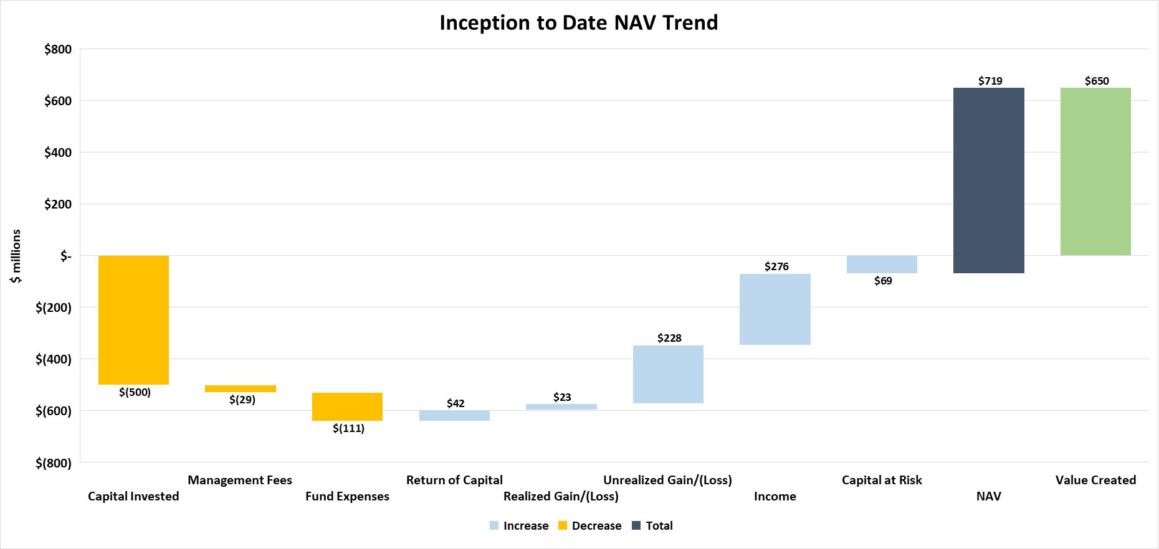
OPEN –
Fund Finance (in progress)

Slide 111
Executive Summary | Key Takeaways
OPEN –
Fund Finance
Debt Availability: We will go out of compliance in the stress test without dispositions, so it is important that we make sure to execute on the disposition plan
Distributions:
Apollo Refi:
Project Double Refi:
Development Projects (Miller & Crescent):
Dispositions: Benigno went hard and Kennedy likely to go hard soon
Occupancy

Slide 112
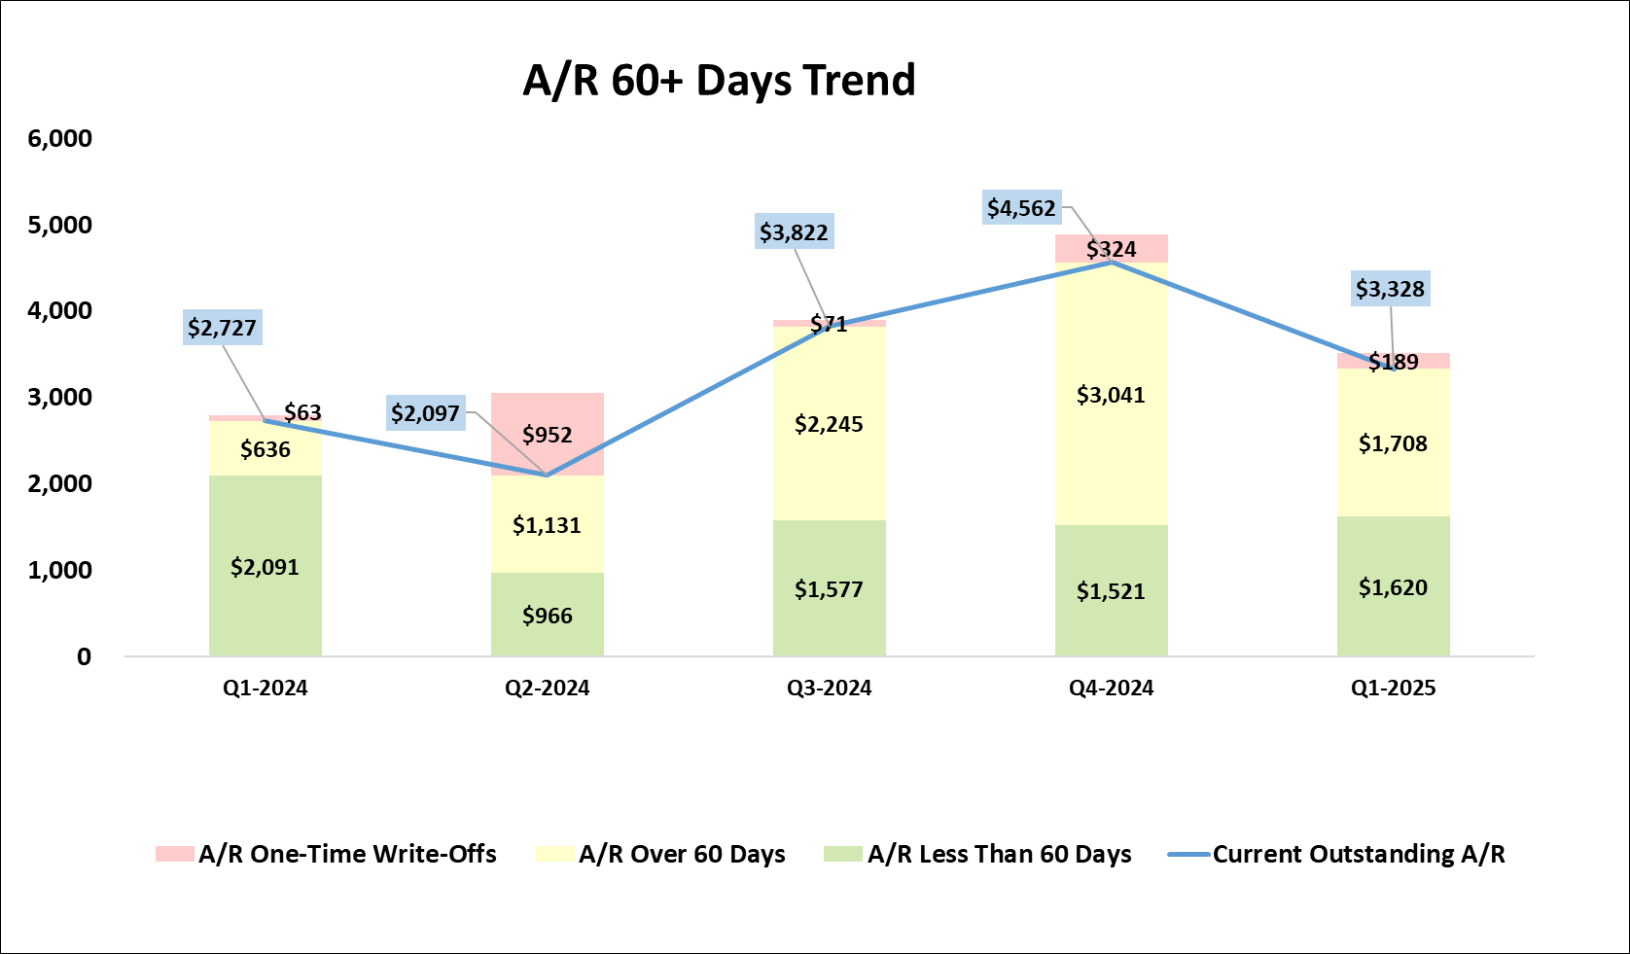
A/R Aging & Trend Analysis
Return
Key Takeaways
Q1 2024: A Stable Start to the year began with relatively low overdue A/R ($636K) and manageable total A/R ($2.73M). Collections appeared to be in control, with minimal write-offs ($63K). Q2 2024: Faropoint wrote-off a large sum of the A/R we didn’t expect to collect. The overdue A/R began to rise to $952K, and total A/R declined slightly to $2.1M. A Few receivables were not being collected on time, resulting in a moderate increase in overdue balances. Q3 2024: A noticeable change occurred when in Q3, with overdue A/R jumping to $2.25M—more than doubling compared to Q2. the reasoning was due to Faropoint expecting to collect some the outstanding A/R balances. The Total A/R increased to $3.82M, indicating higher invoicing activity, but collections did not keep pace, resulting in a large backlog of overdue balances. Q4 2024: Challenges By Q4, overdue A/R reached its highest level at $3.04M, accounting for nearly 67% of total A/R ($4.56M). The trend suggests continued struggles with collecting older invoices, potentially reflecting customer financial difficulties. Despite this, write-offs remained low, implying we Faropoint are still attempting to recover these overdue amounts.
Q1 2025: Overdue A/R significantly reduced from prior quarter of $3.04M to around $1.7M. While the A/R less than 60 days increased slightly, the reduction in over 60 days without large write-offs means we were successful in recovering overdue amounts.
* Net Collections is an adjusted figured, representing aggregate gross collections during the Quarter less new billings during the quarter.

